Slide 1
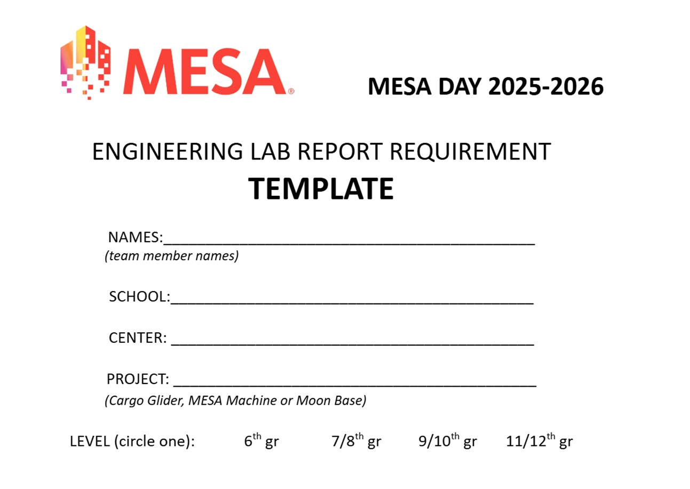

Slide 2
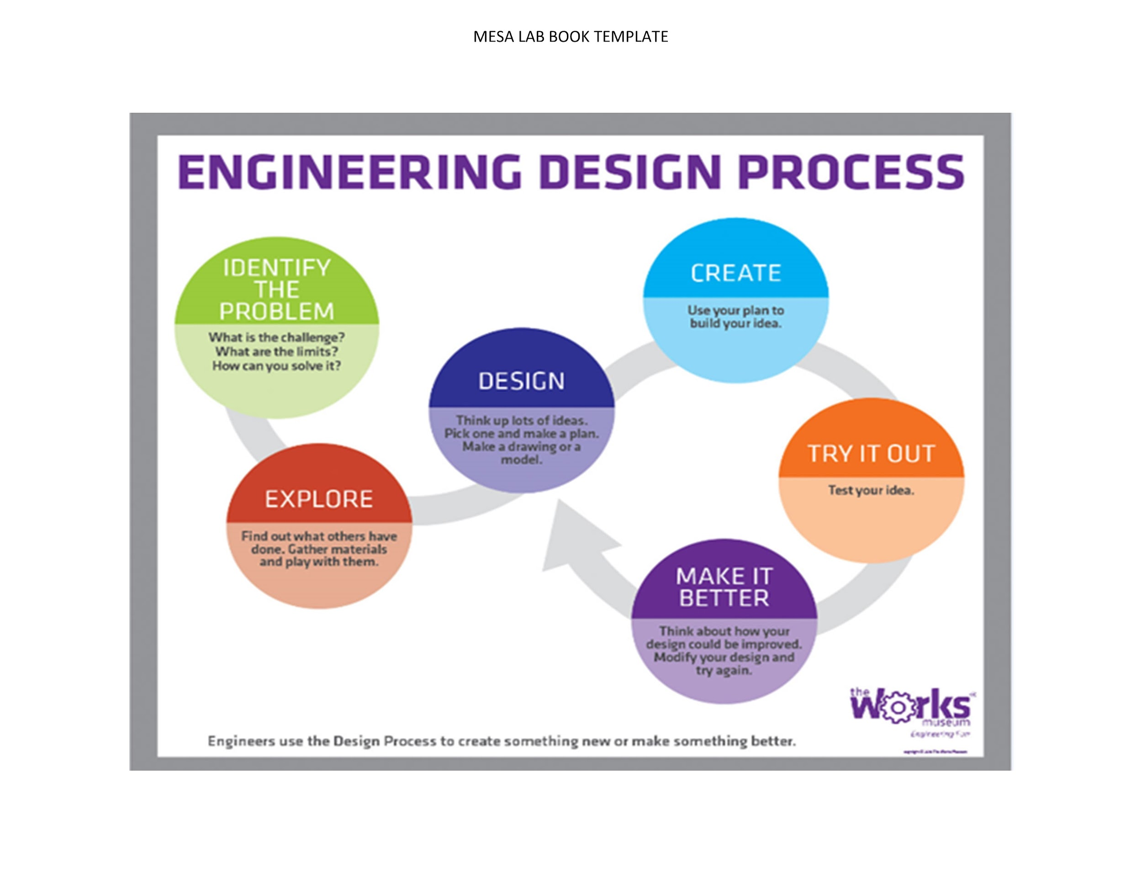
Lab Report Template

Slide 3
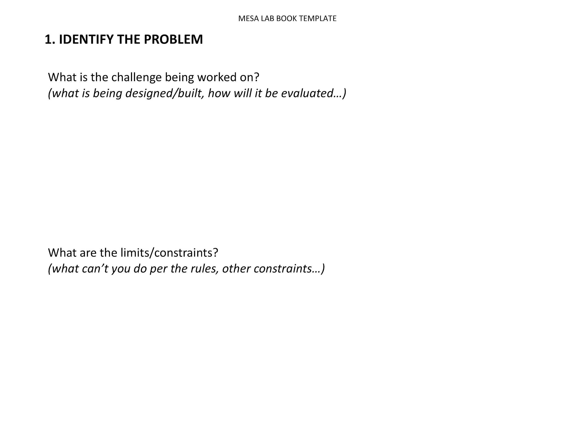
Lab Report Template

Slide 4
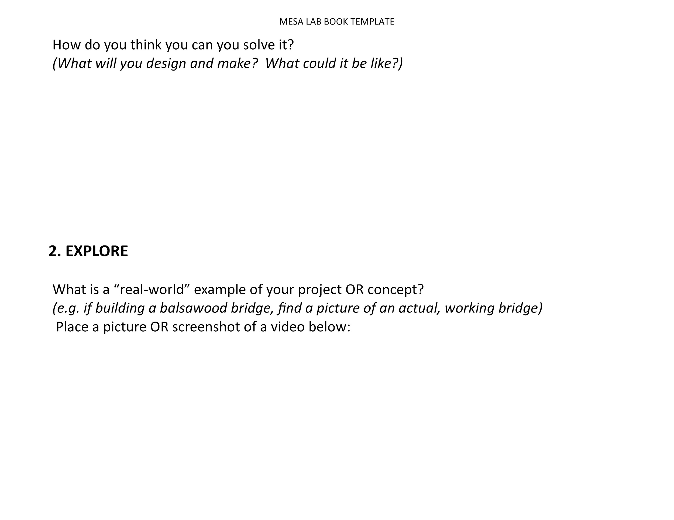
Lab Report Template

Slide 5
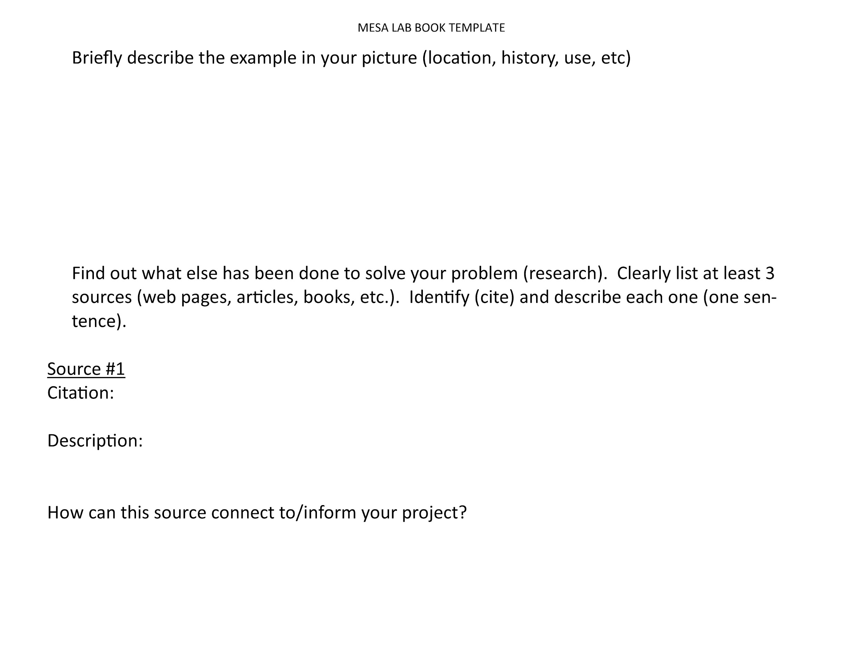
Lab Report Template

Slide 6
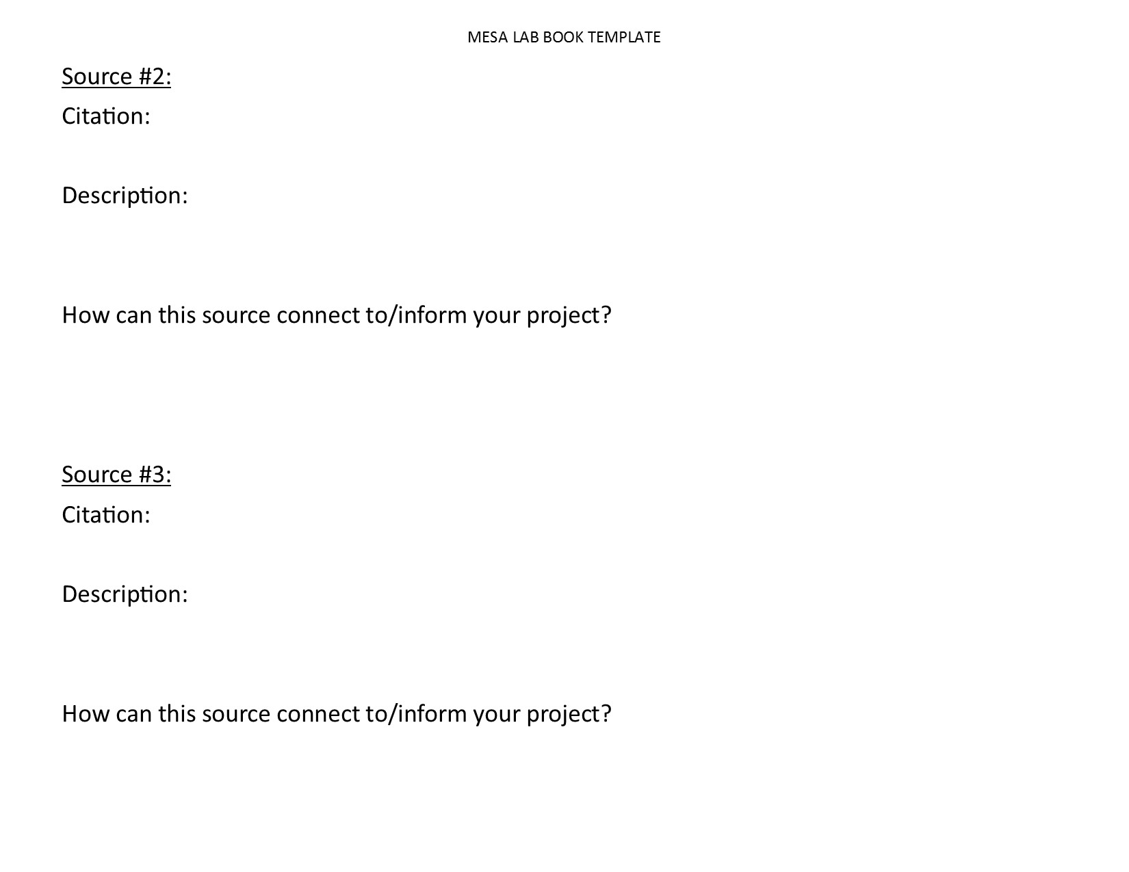
Lab Report Template

Slide 7
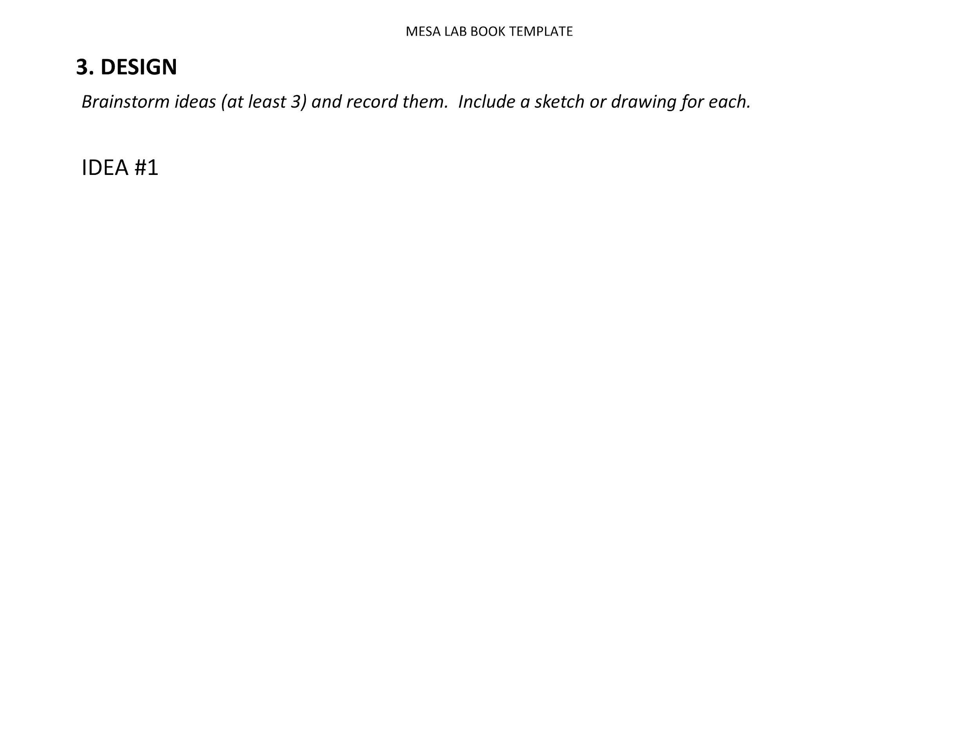
Lab Report Template

Slide 8
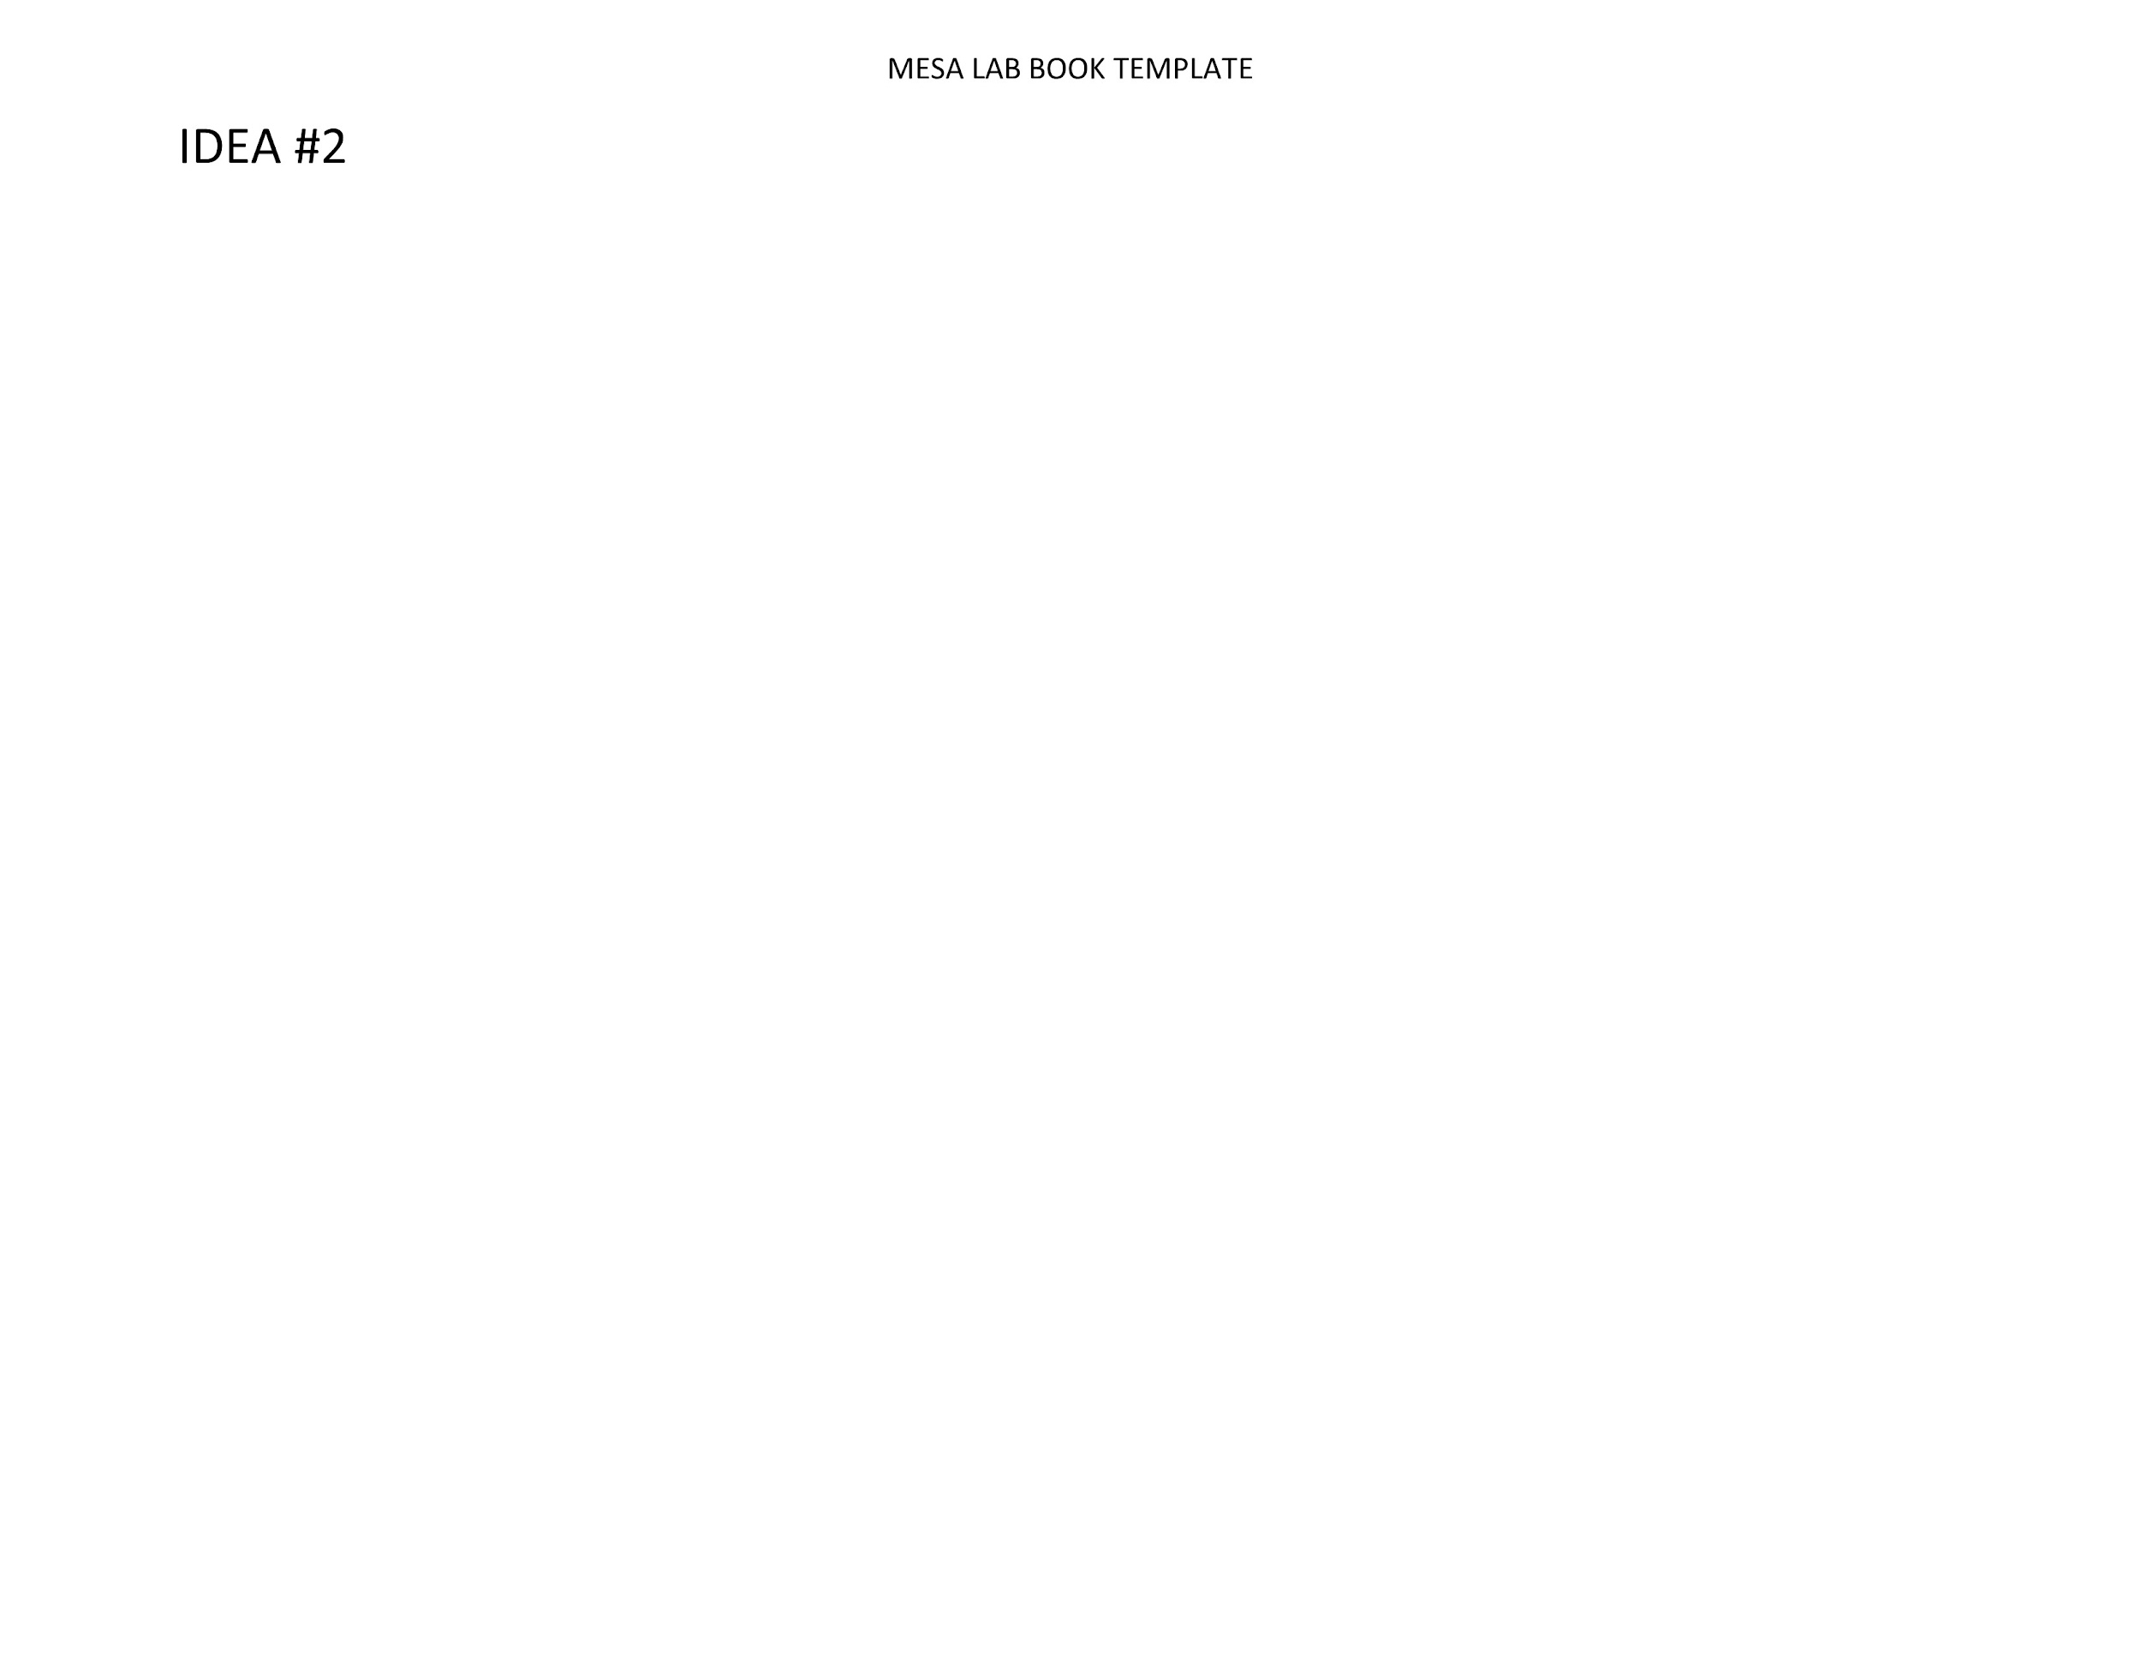
Lab Report Template

Slide 9
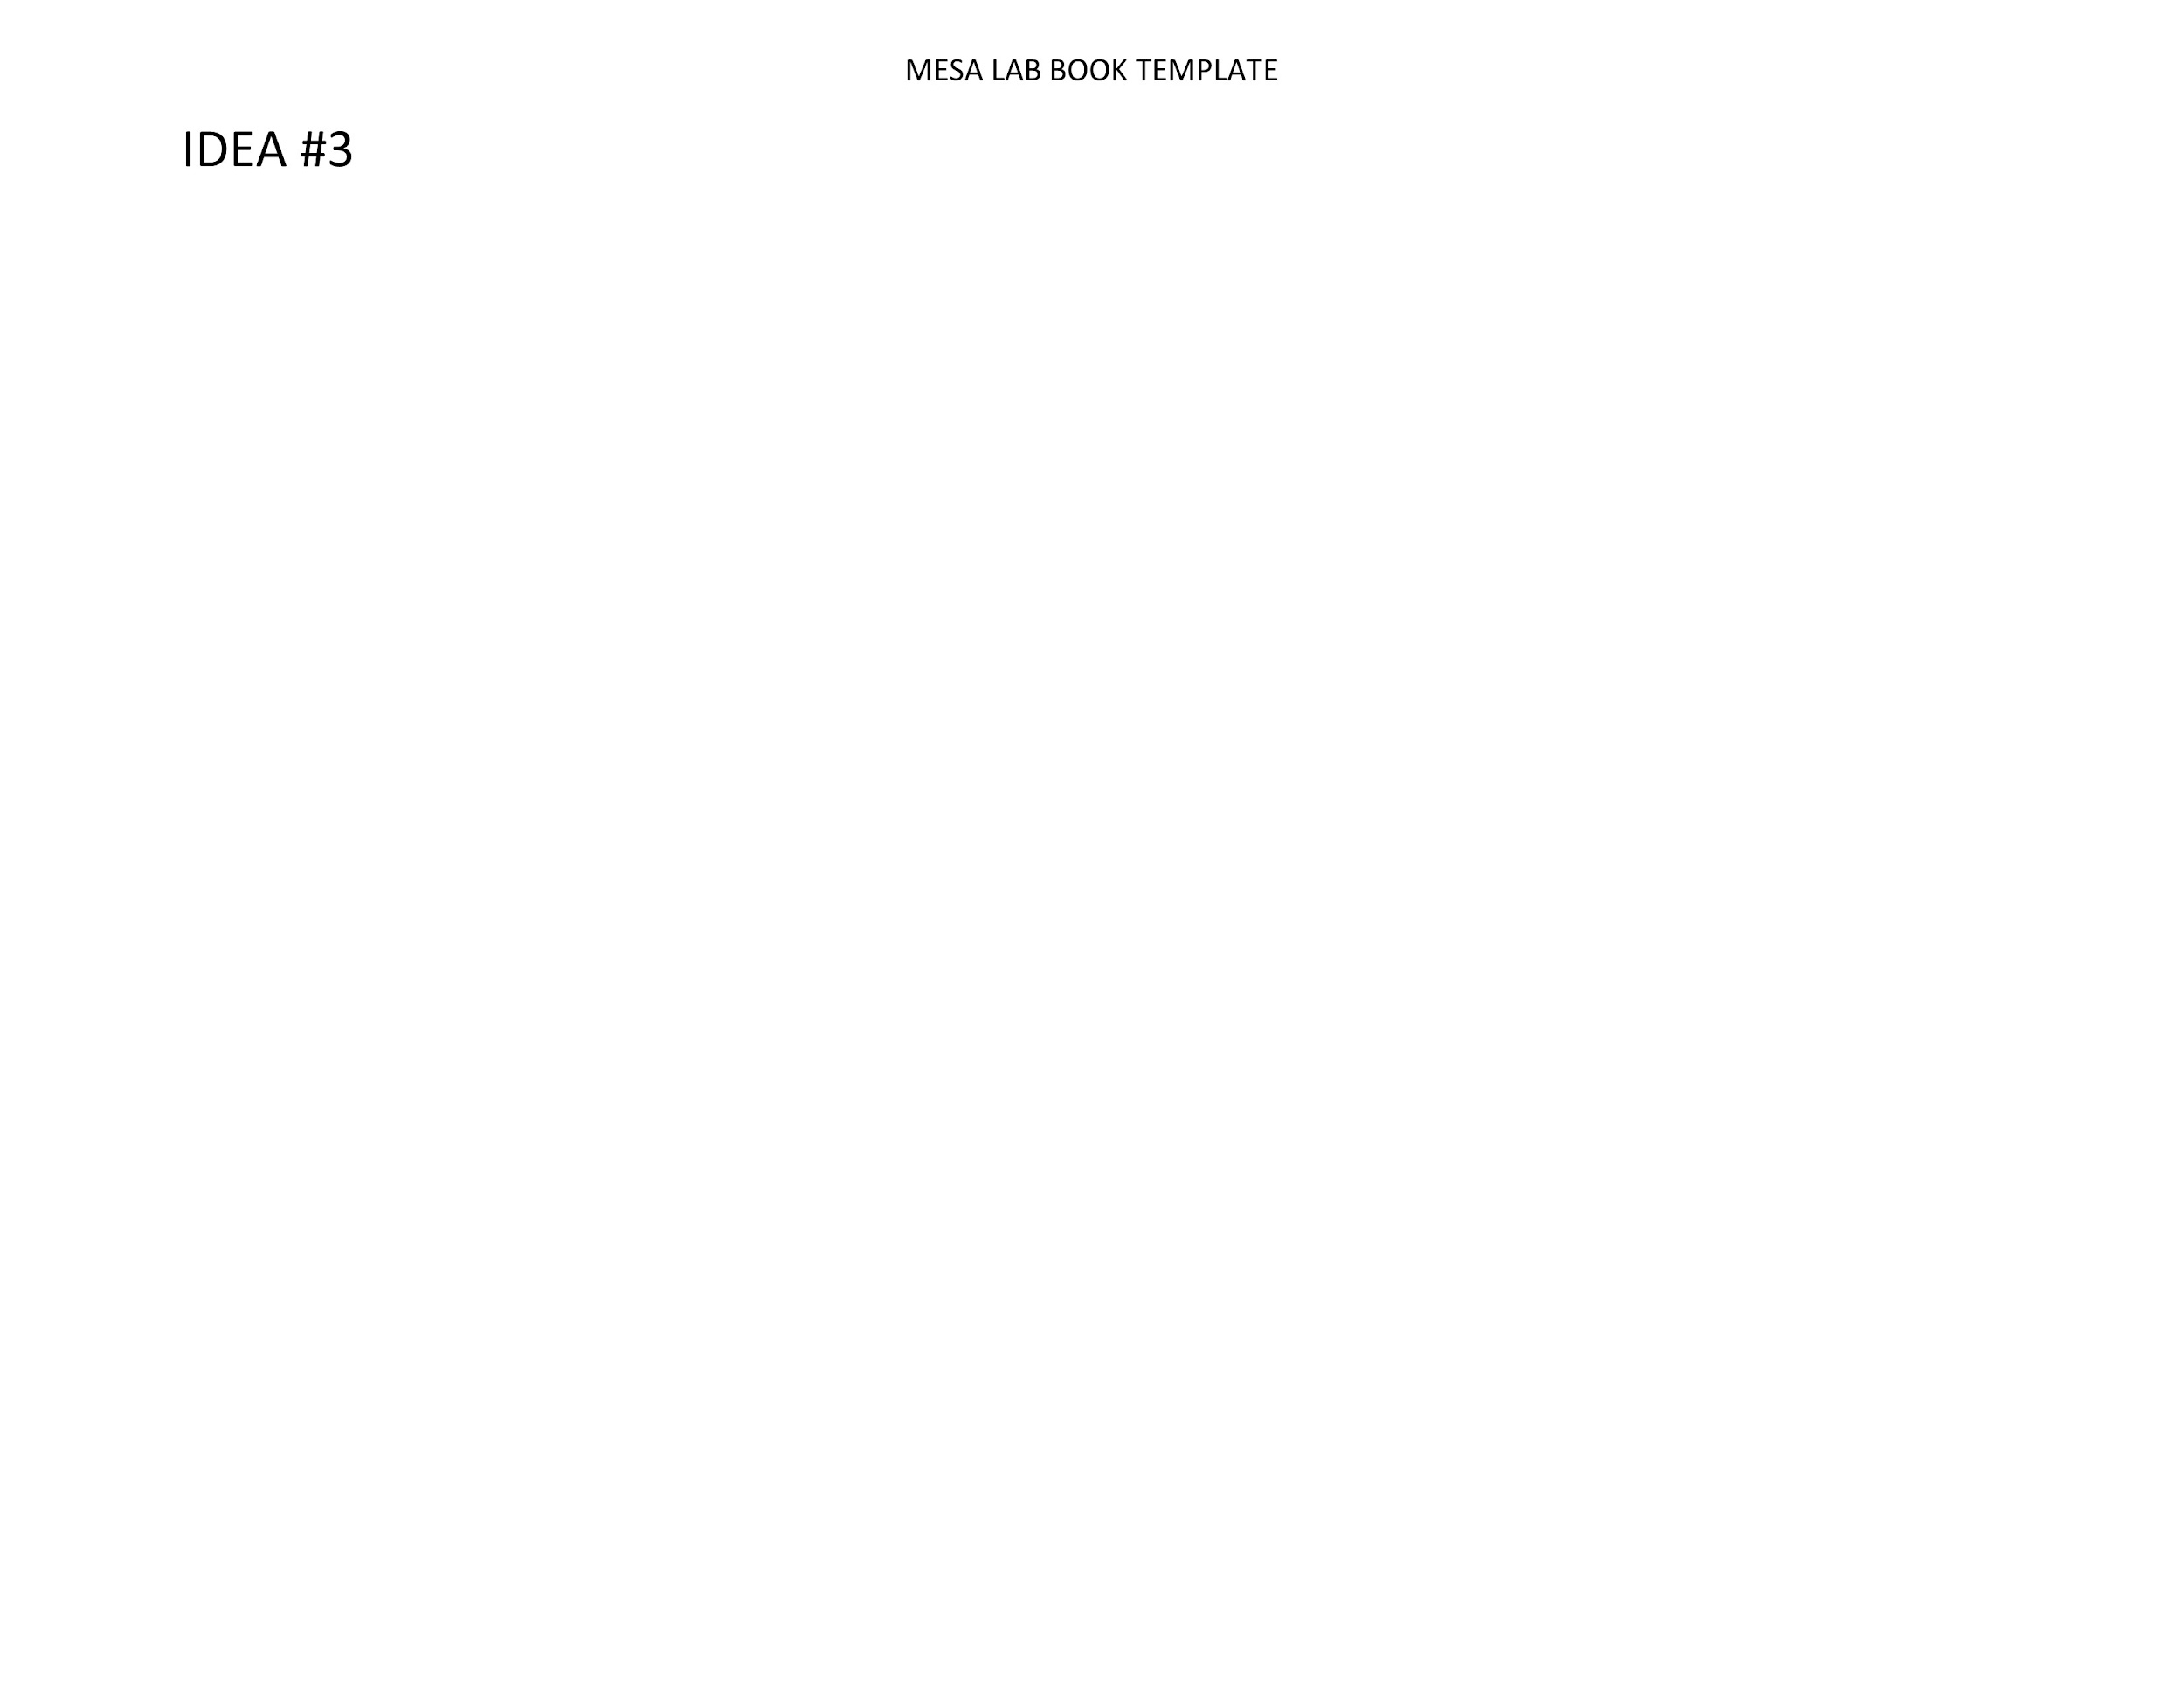
Lab Report Template

Slide 10
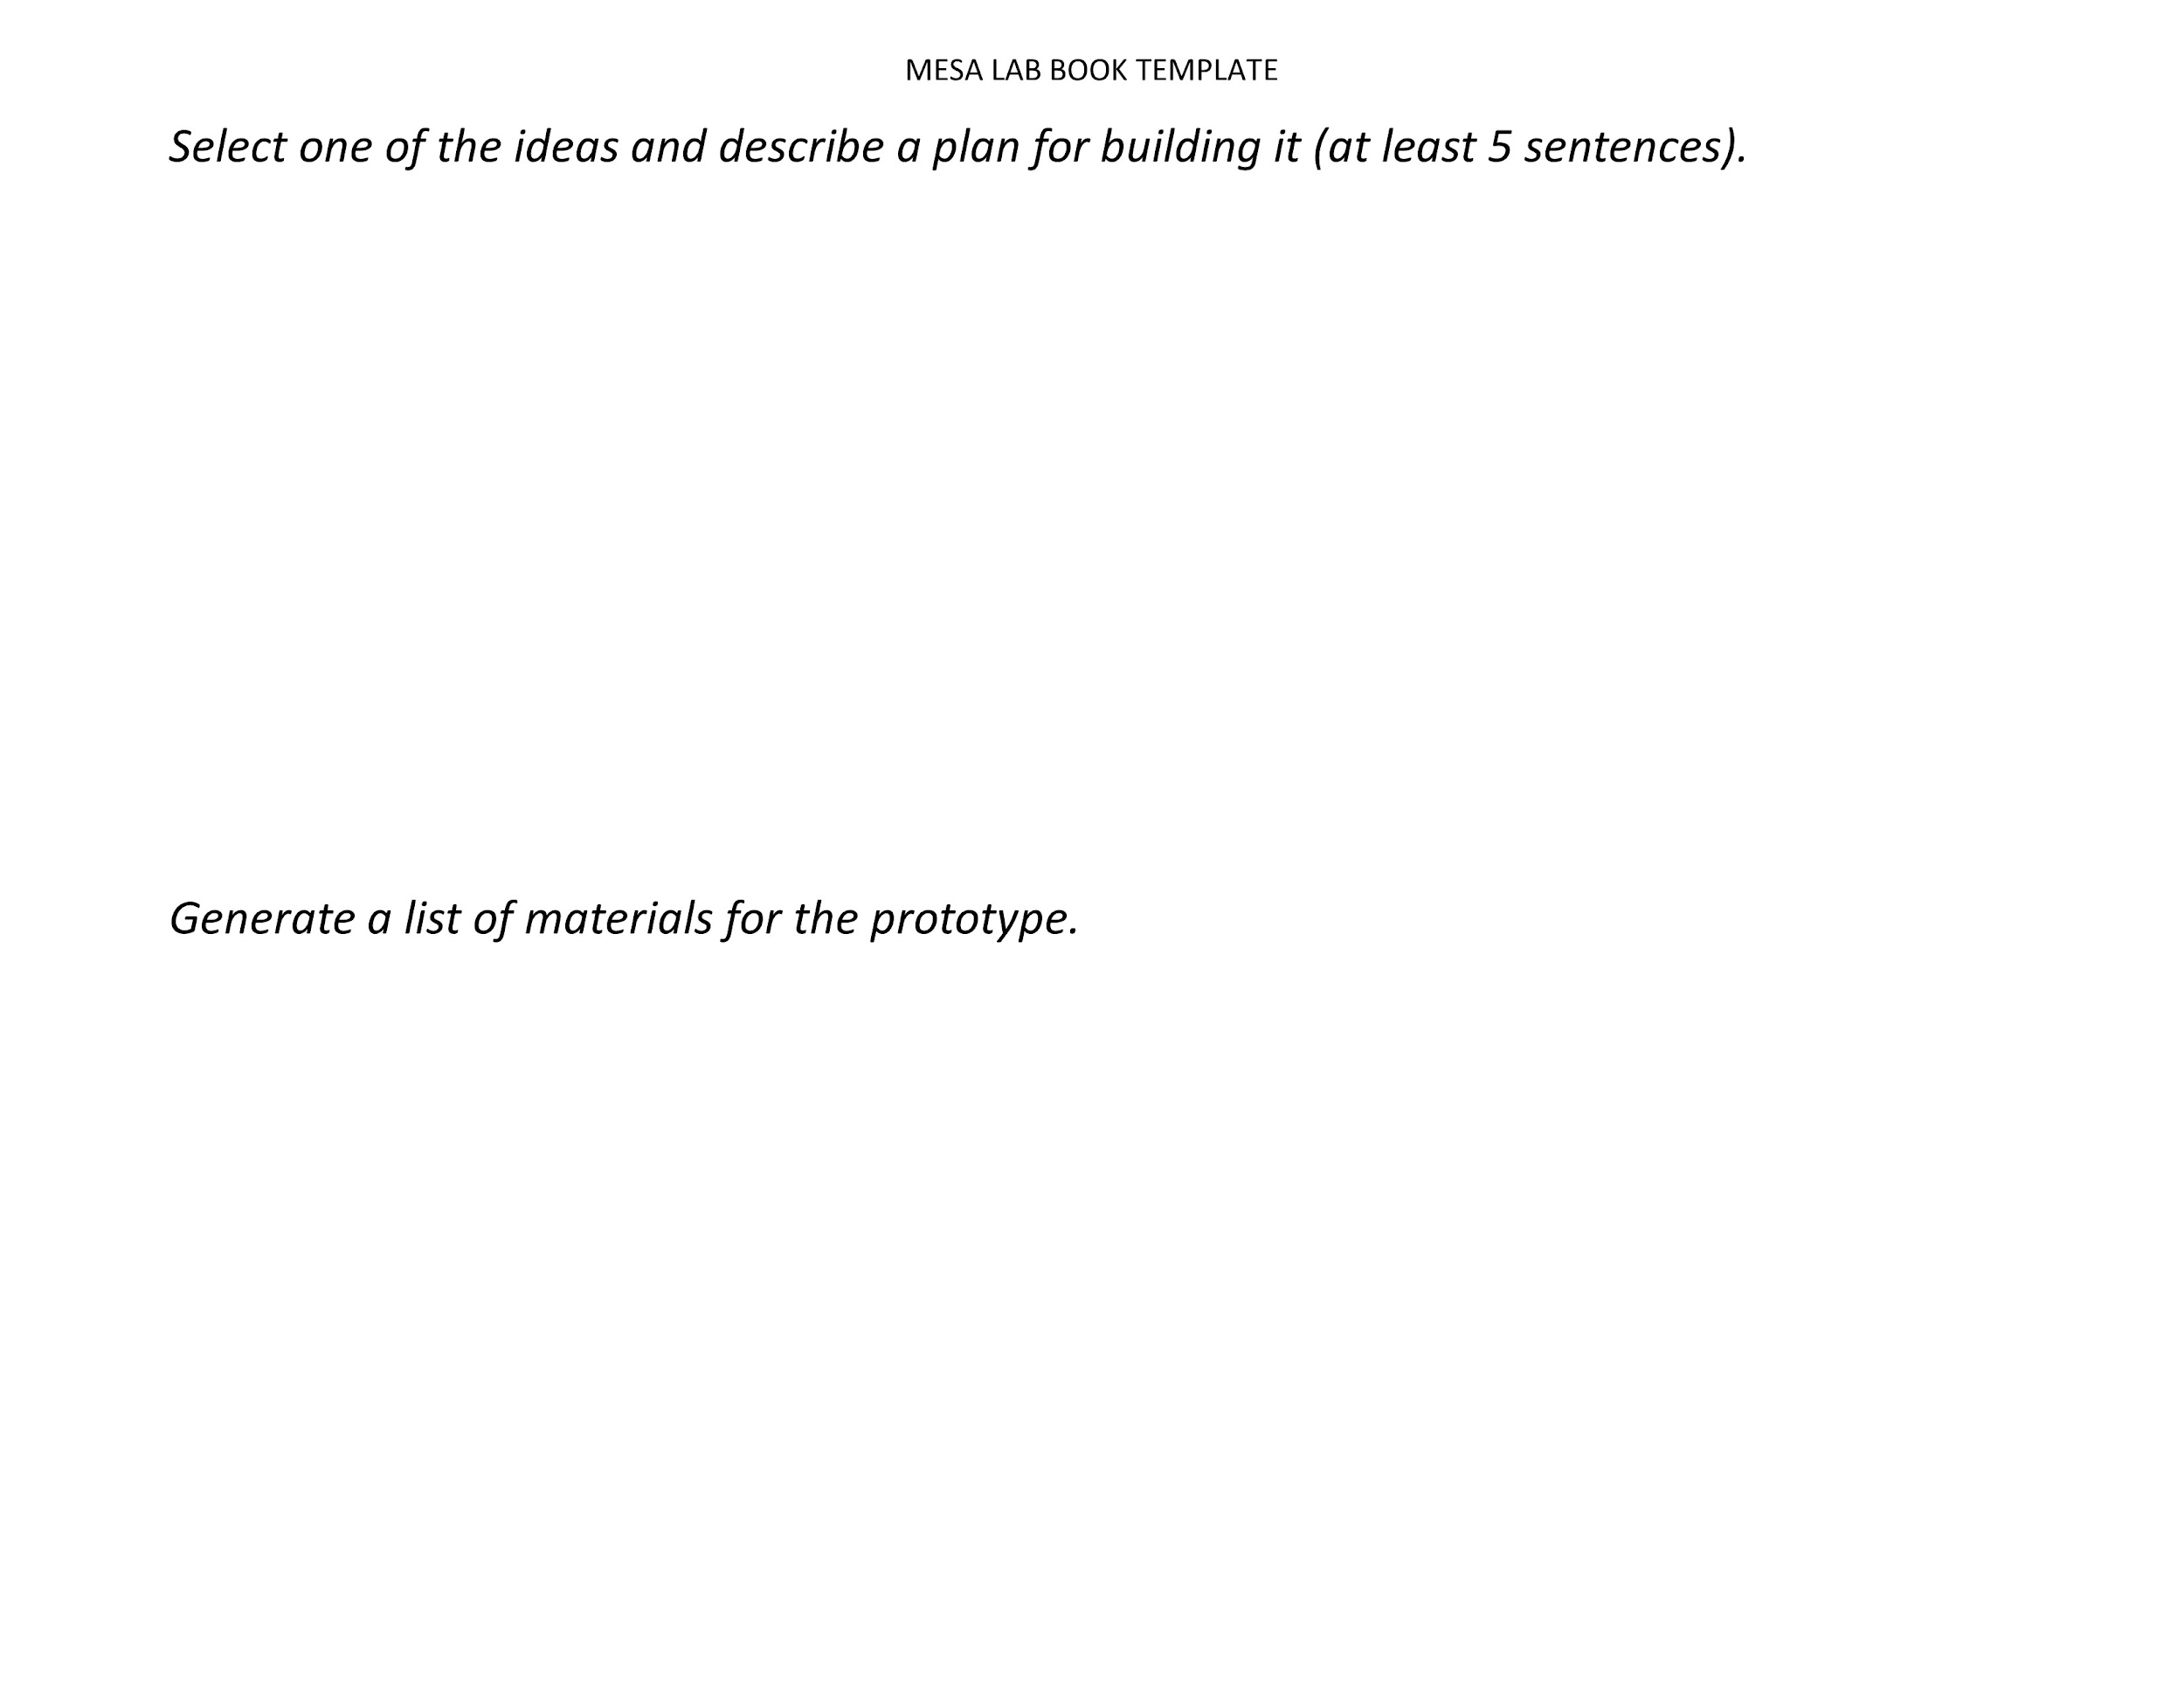
Lab Report Template

Slide 11
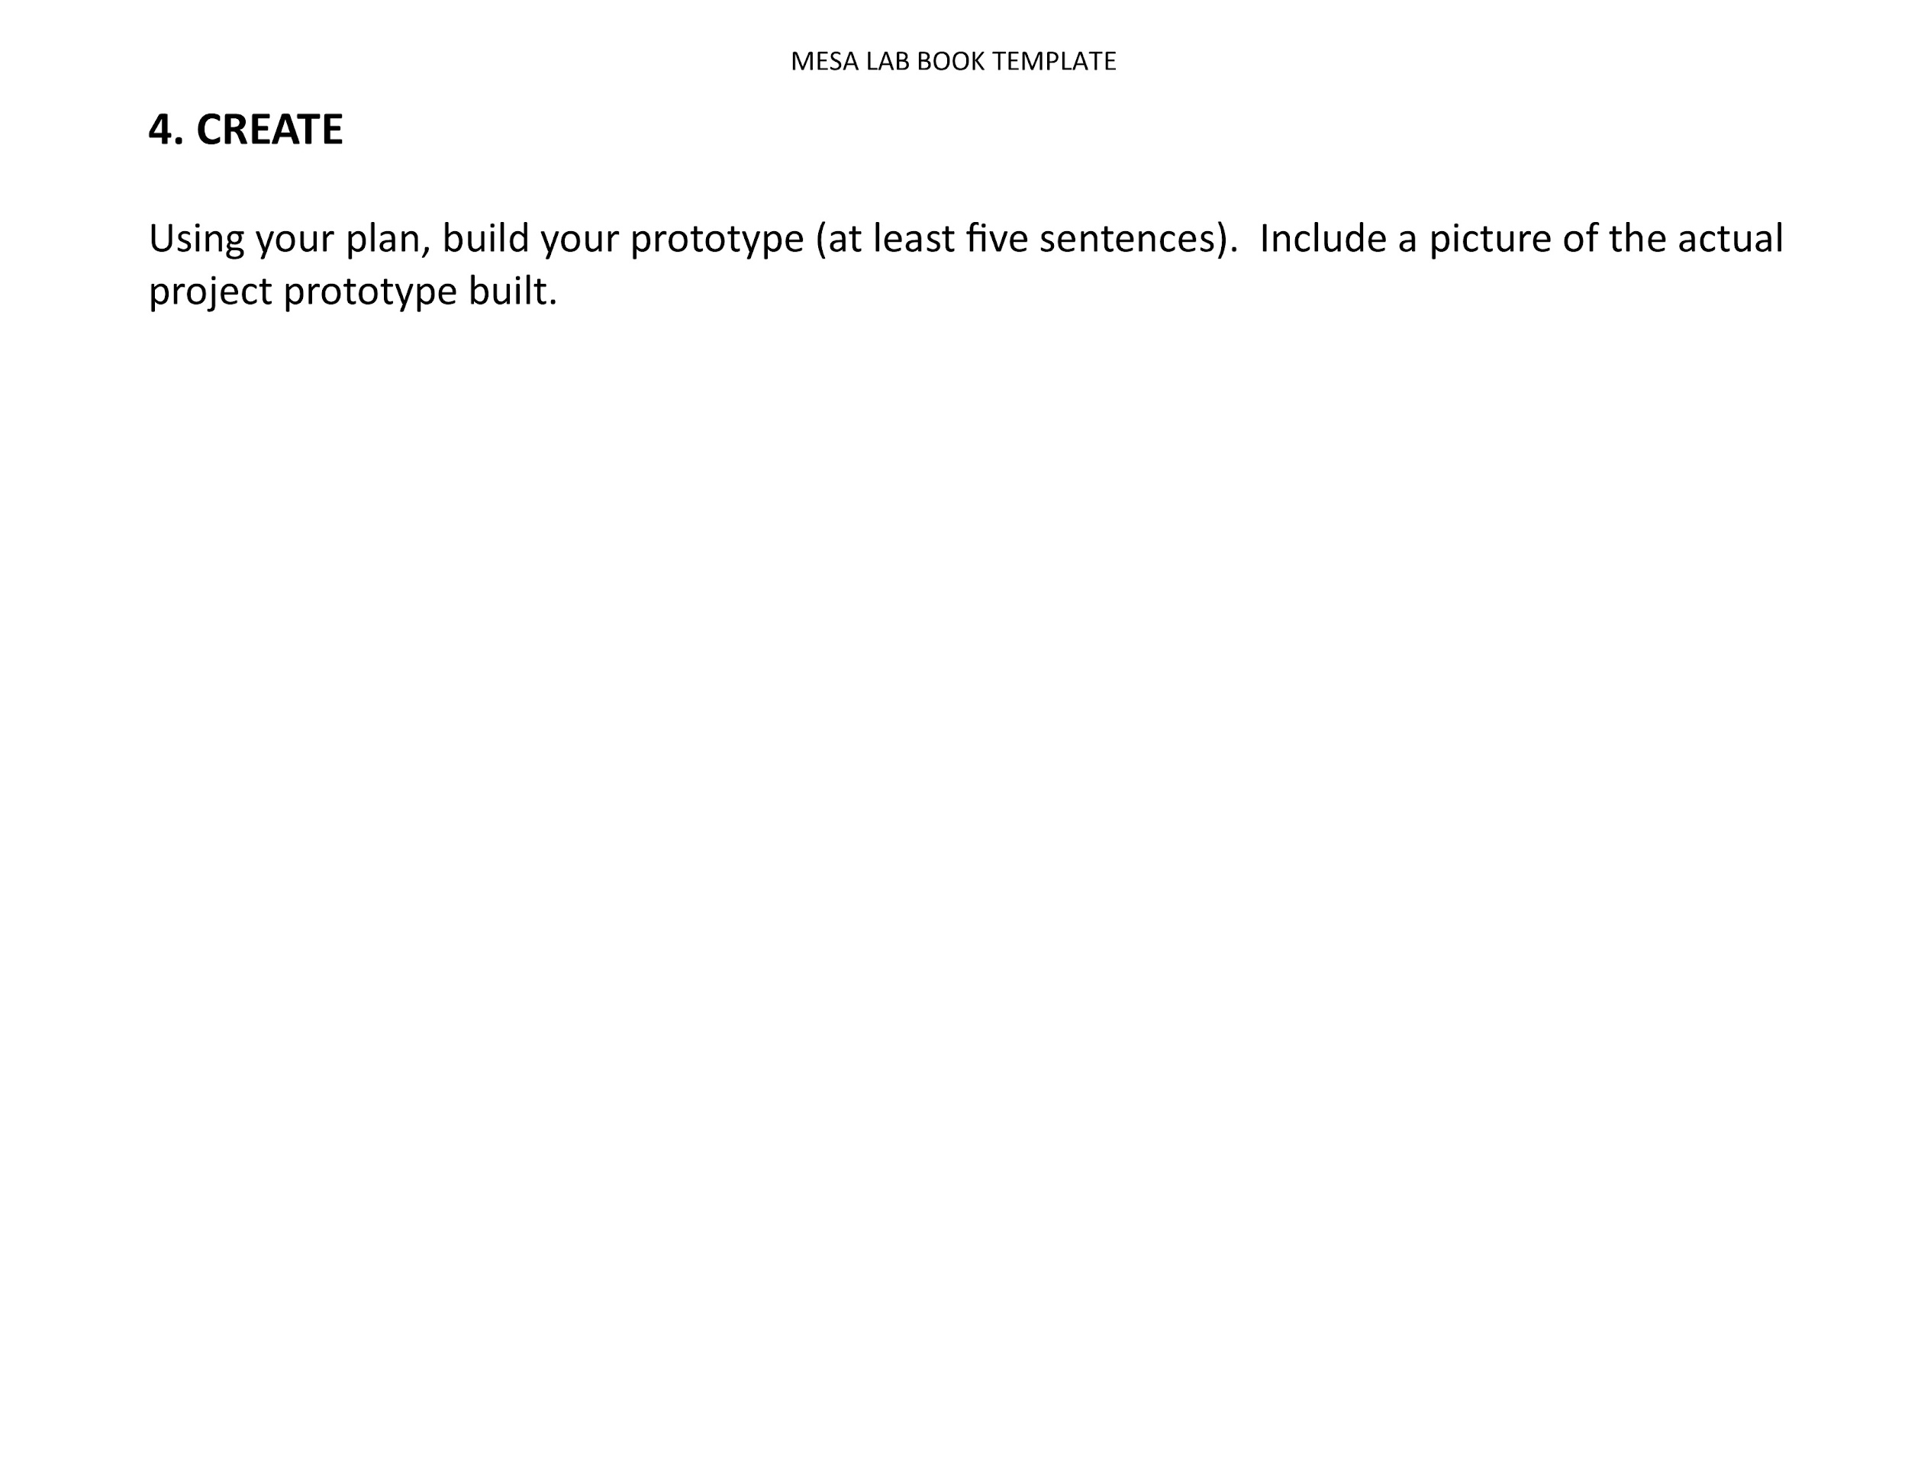
Lab Report Template

Slide 12
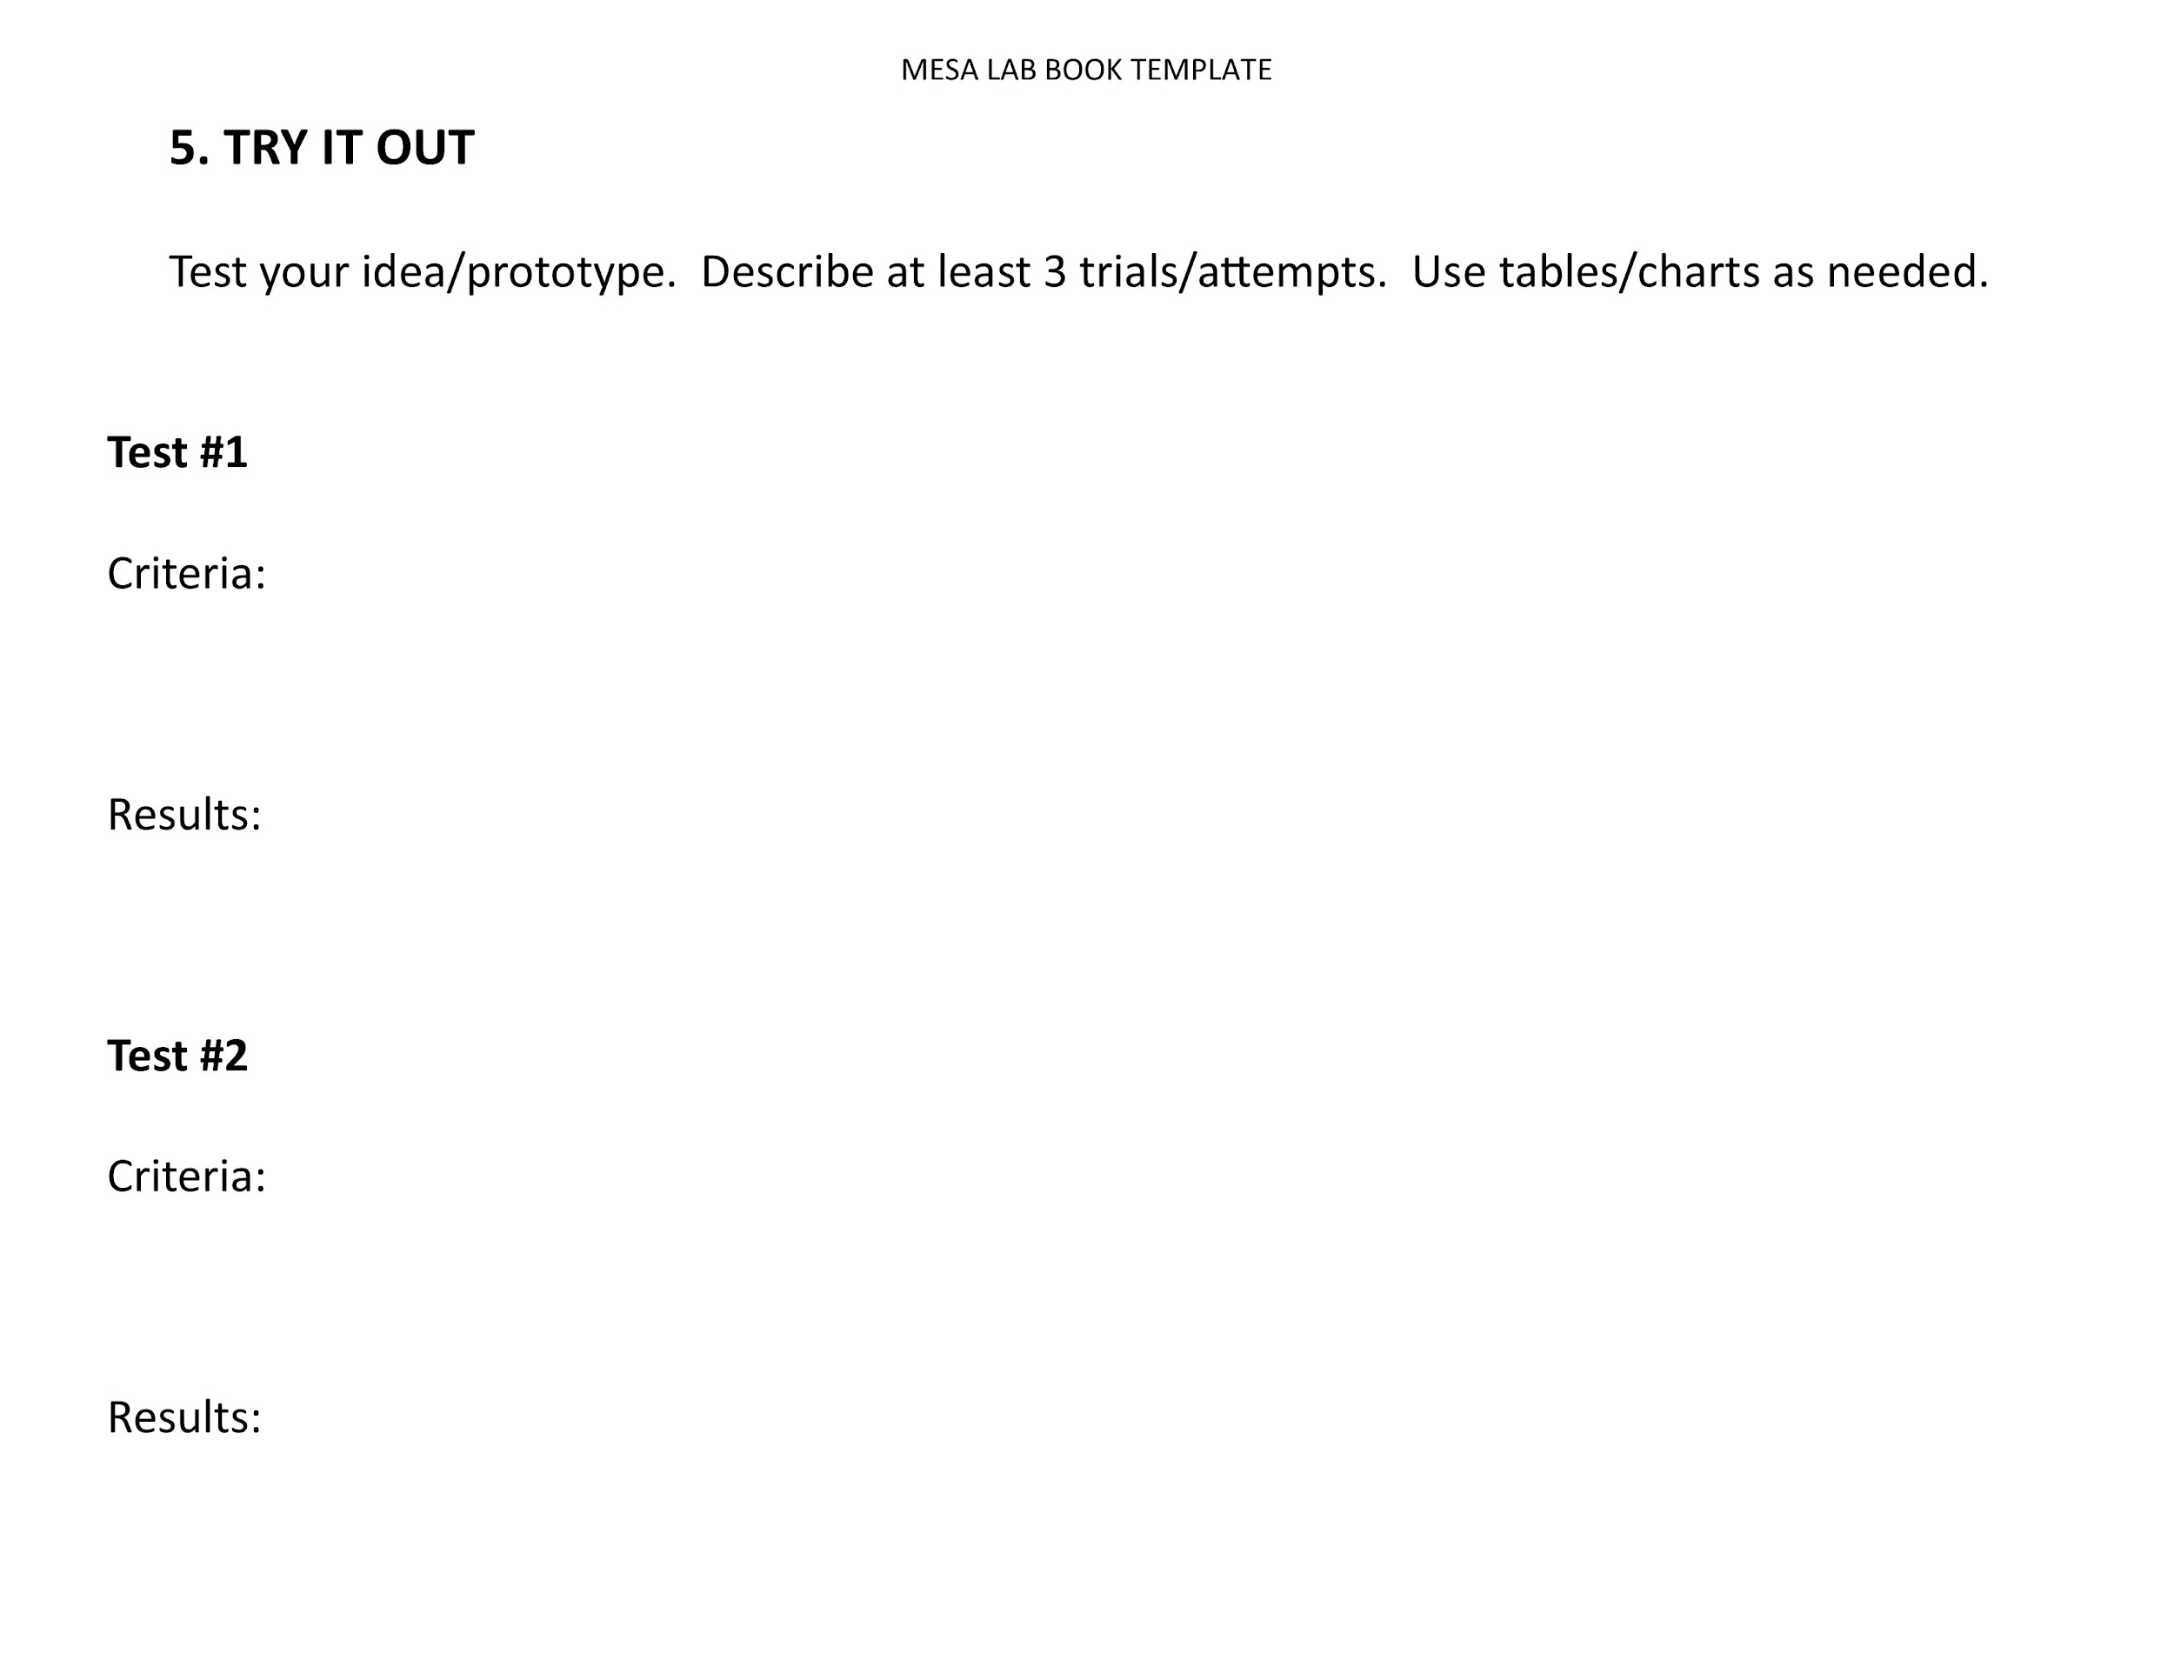
Lab Report Template

Slide 13
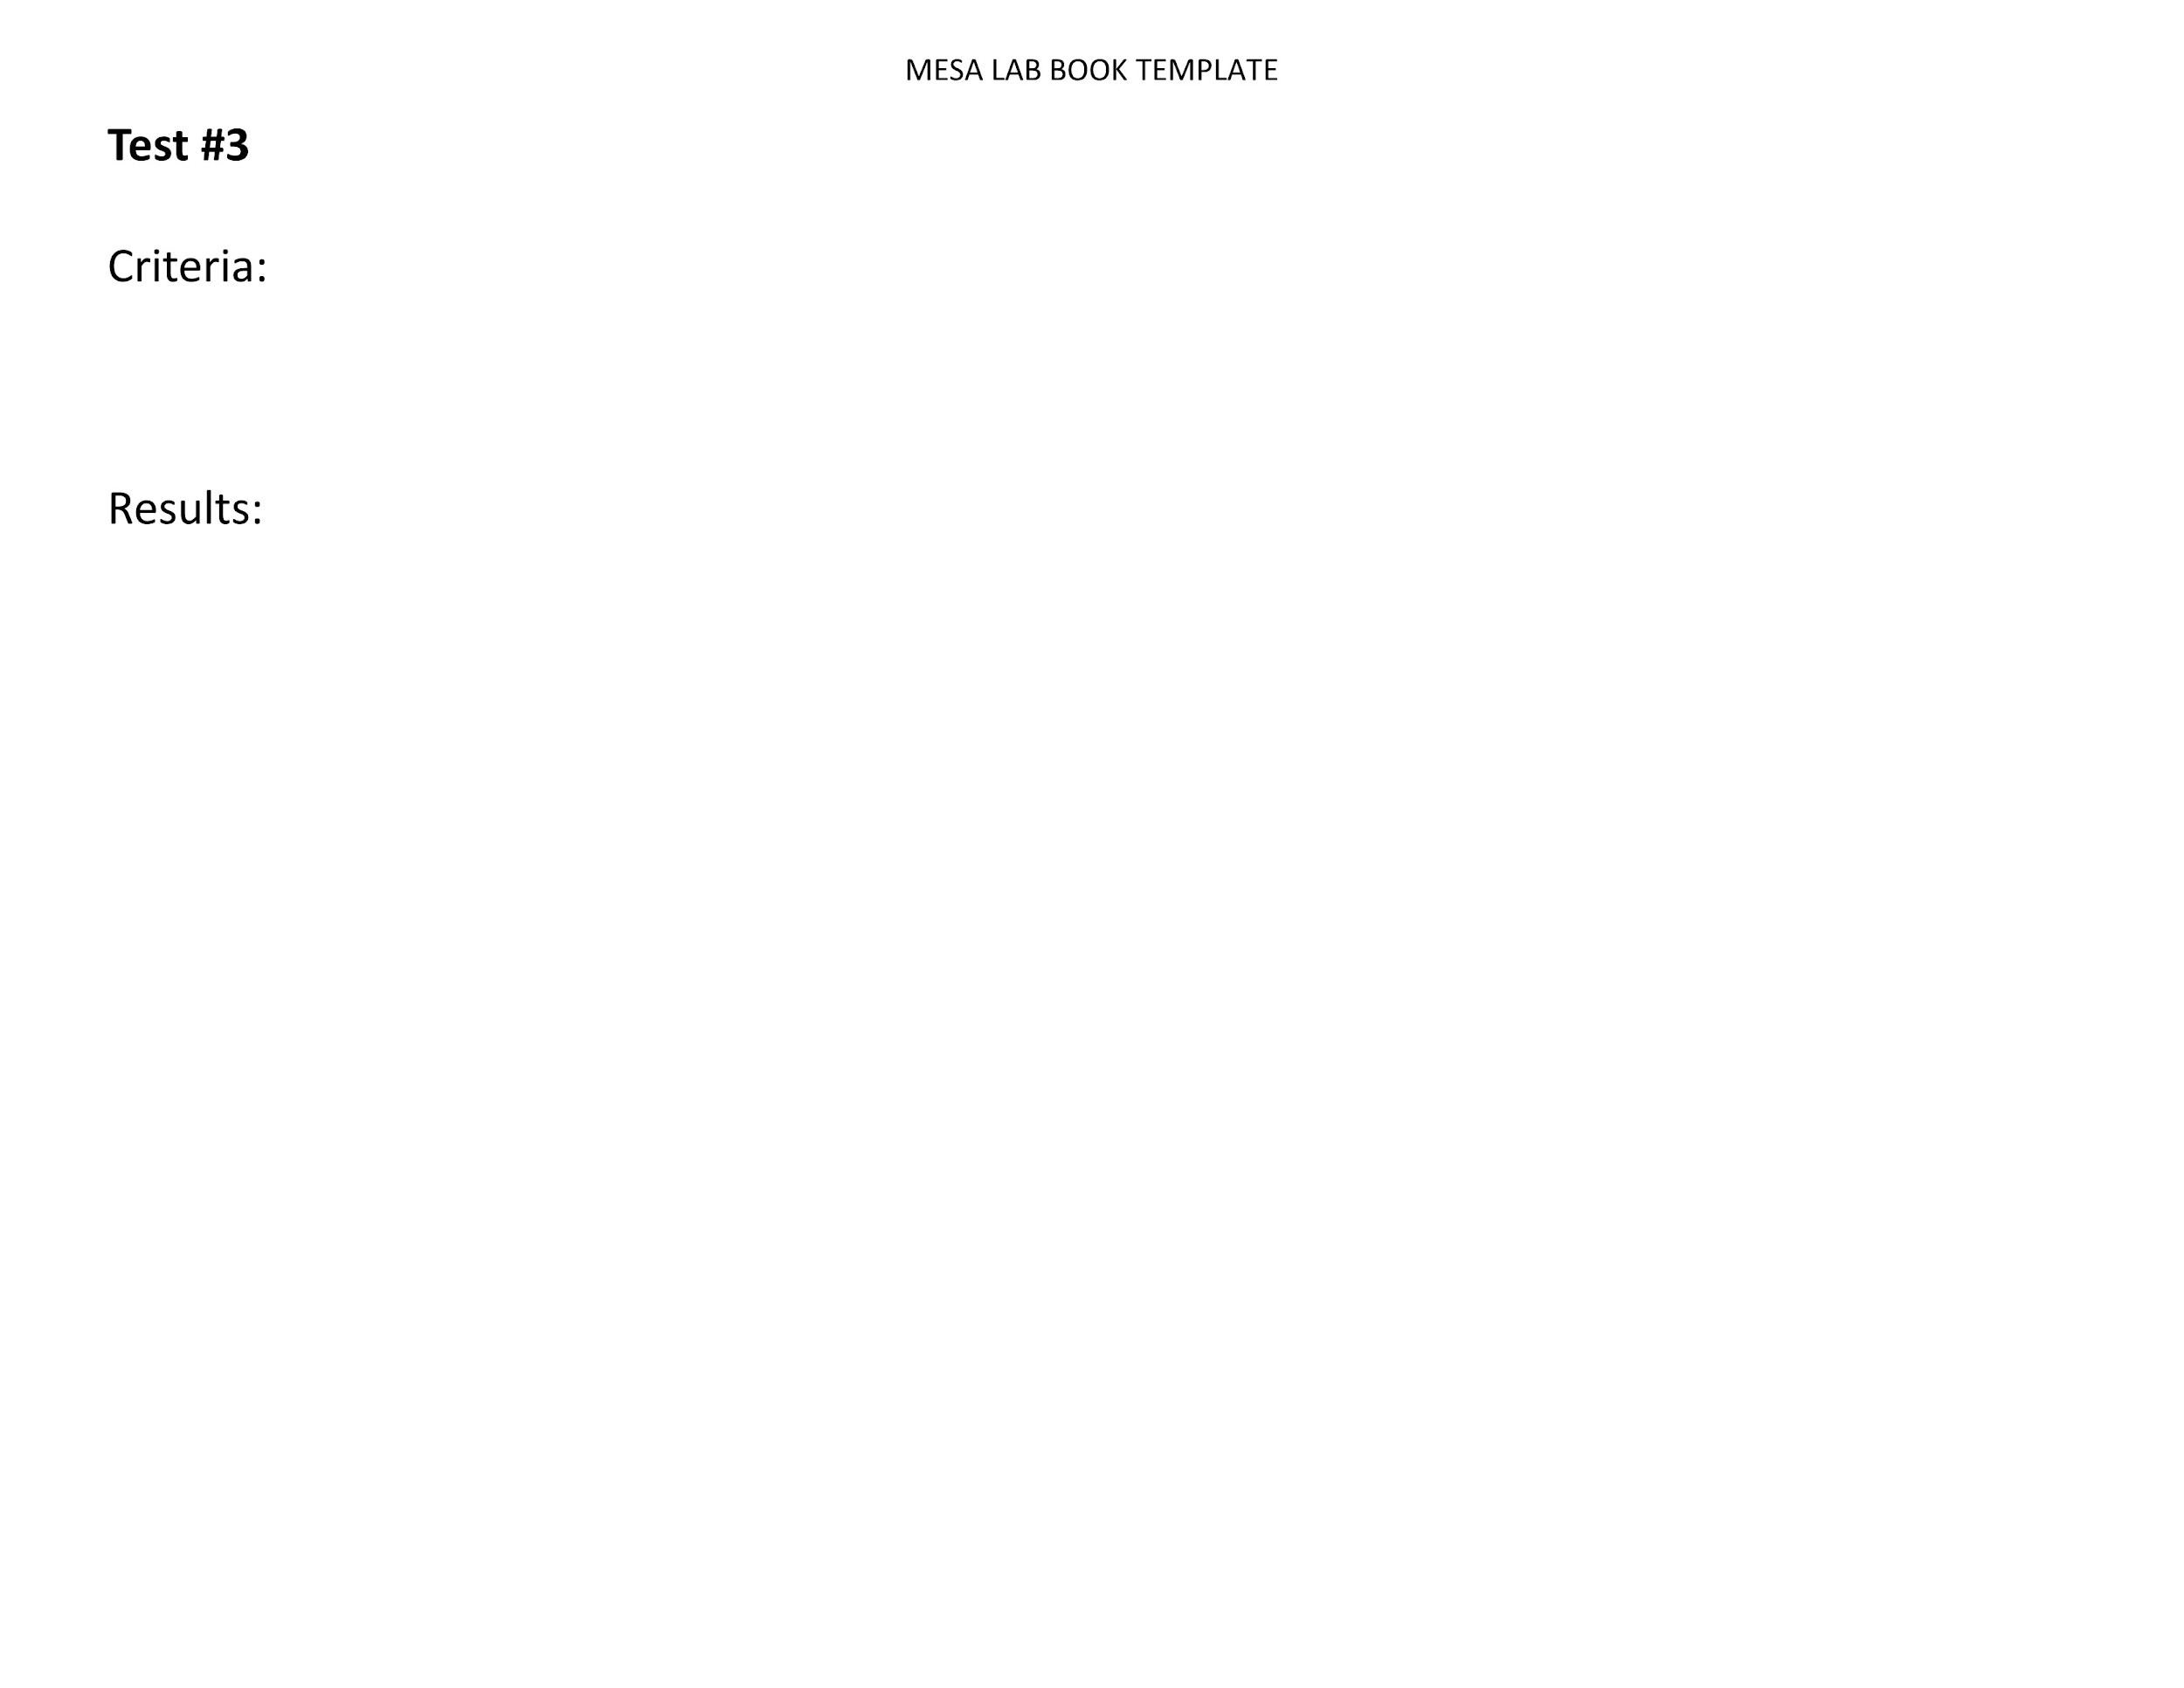
Lab Report Template
*Teams may include additional tables, graphs and charts of their own. Teams are not limited to only using the graph and table shown here.

Slide 14
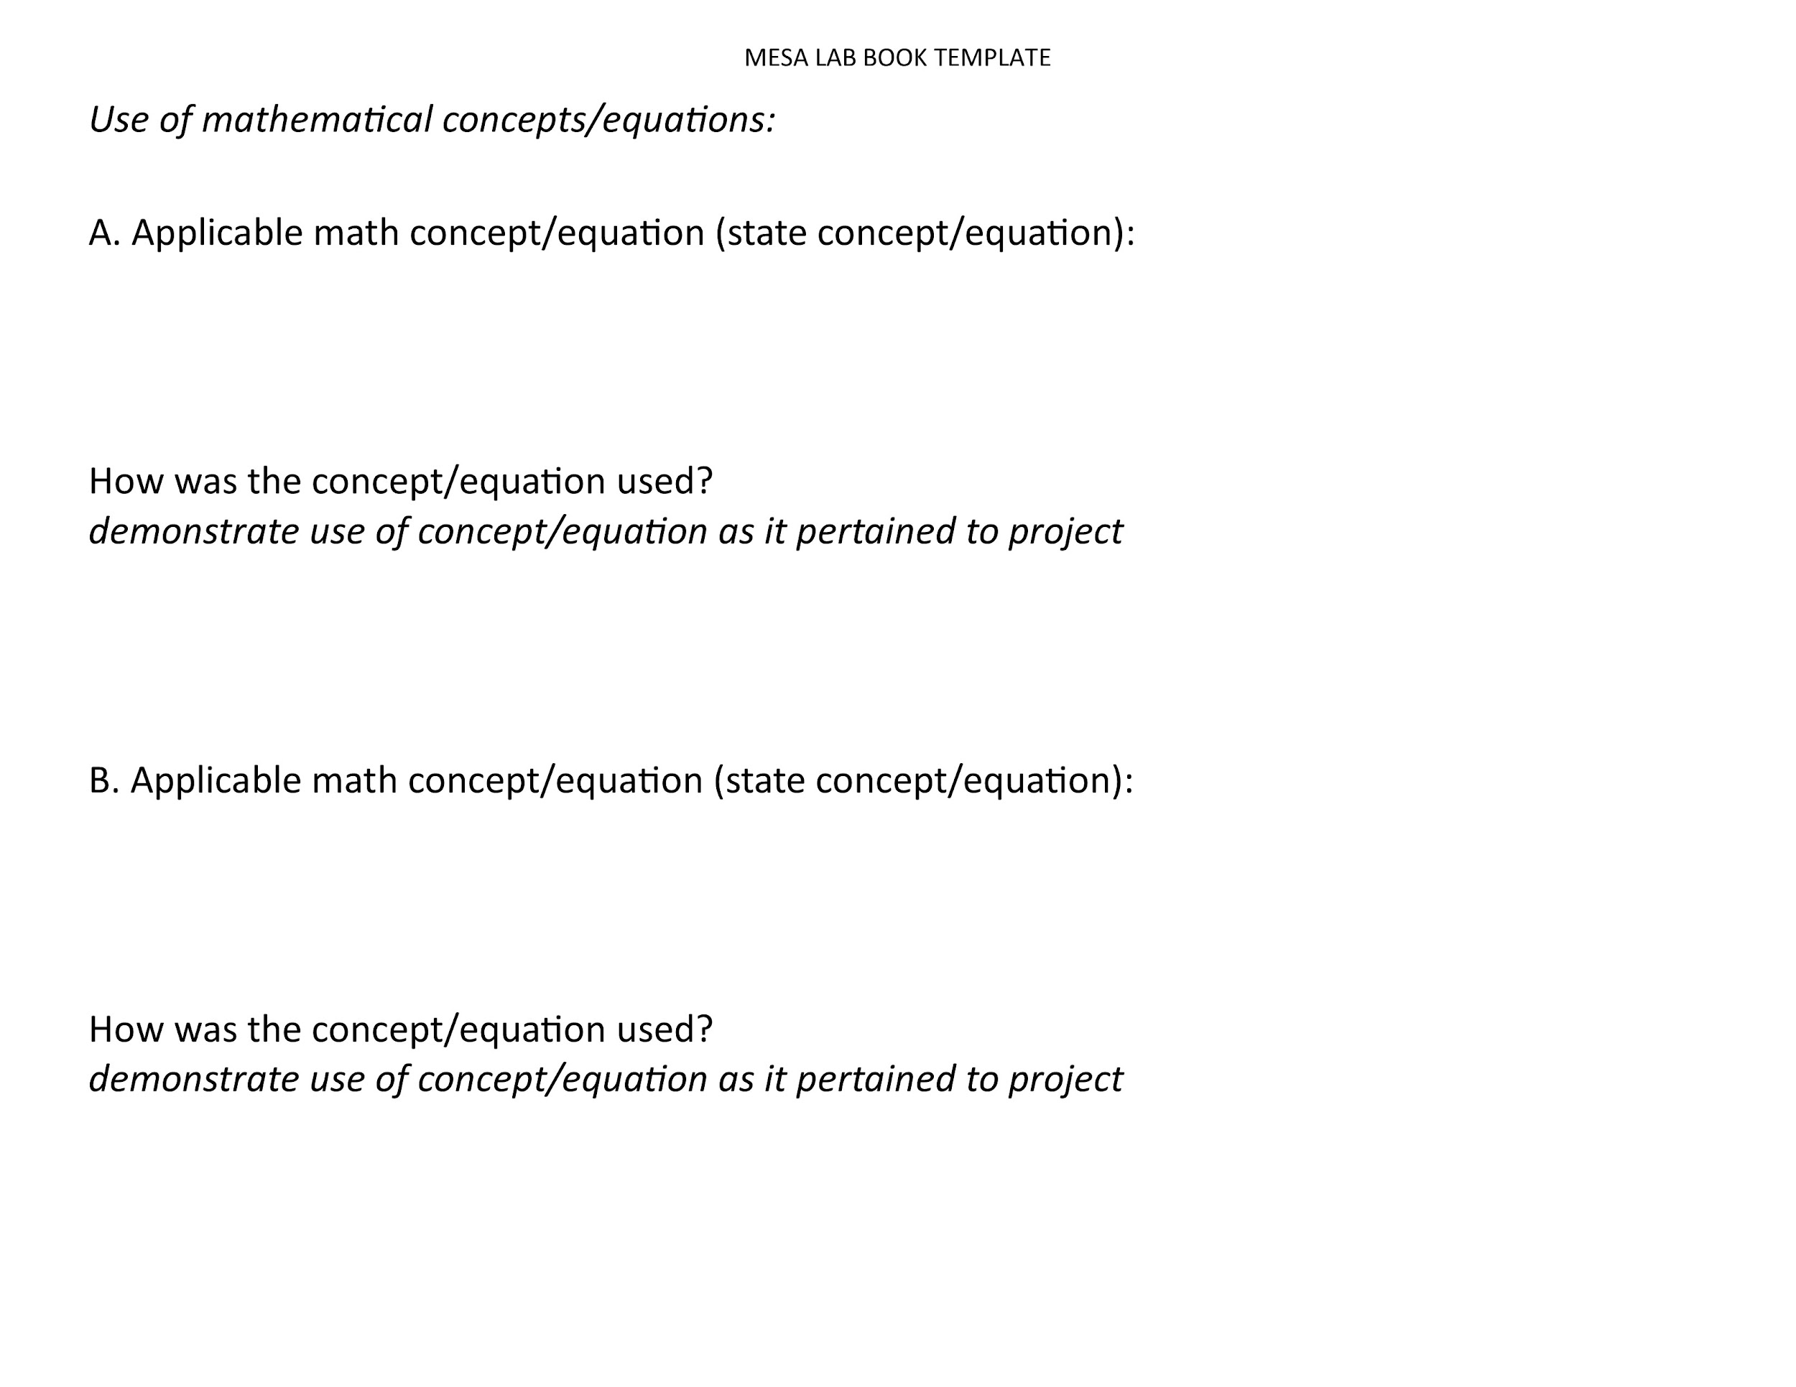
Lab Report Template

Slide 15
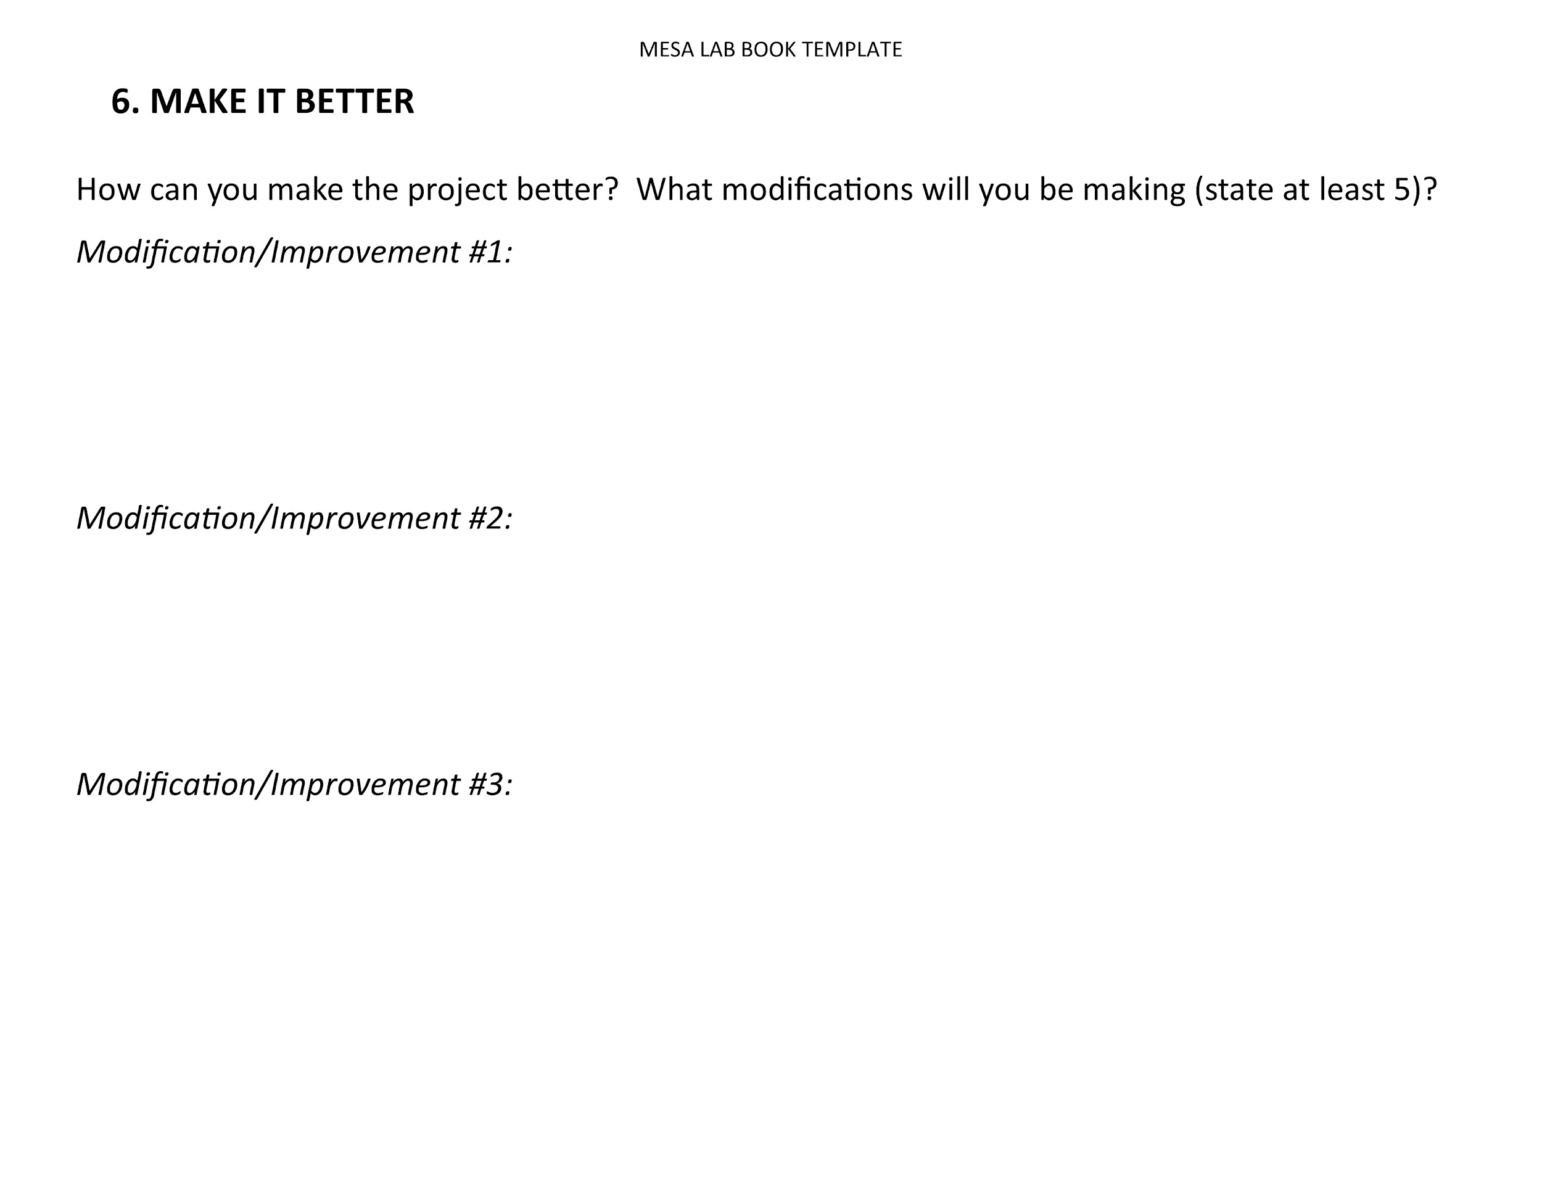
Lab Report Template

Slide 16
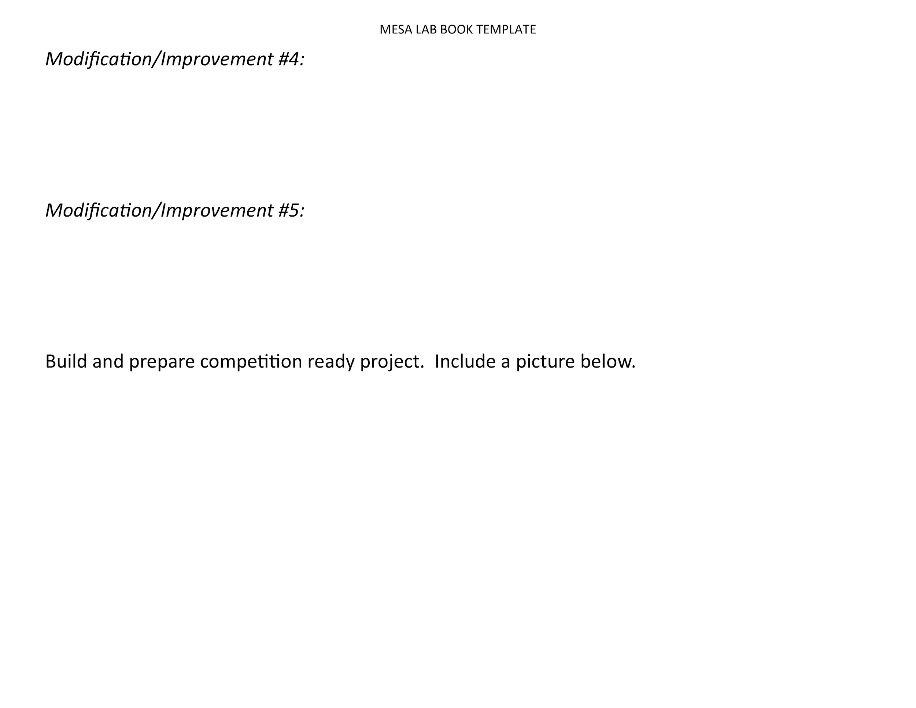
Lab Report Template

