Slide 1
MESA Prosthetic Arm Competition

Slide 2
General Guidelines
2 - 3 students per team
Grades 6, 7/8, 9/10, 11/12
Materials:
Anything, excluding hazardous materials
Device MUST be labeled with:
Full names, school, grade, MESA center

Slide 3
General Guidelines
MUST have at least two artificial fingers
Two are REQUIRED to move
Arm operating device MUST be immobilized
Unencumbered arm can only be used to hold and organize the workspace
MUST have engineering notebook

Slide 4
Engineering Notebook
Introduction
One page introduction
Half page description of two different medical reasons why someone might need a prosthetic arm
Only one one can be a type of trauma/injury
Daily Entries
At least 10 dated daily entries

Slide 5
Engineering Notebook
Project Sketches
One anatomical sketch of an arm
One sketch of the final device
Correctly label eight required anatomical structures
Applied Mathematics, calculate:
Work done by fingers (W = Fd)
Grab and release speed of fingers (D = rt)

Slide 6
Required Anatomical Structures
Radius/Ulna
Flexor Carpi Ulnaris
Radiocarpal Joint
Carpus
Carpometacarpal Joint
Metacarpus
Phalanges
Tendons

Slide 7
Engineering Notebook
Must contain “Materials Table”
List of materials utilized for required anatomical structures

Slide 8
Important Judging Notes
Repairs will only be allowed with duplicate parts/materials
Only two non-consecutive trials are allowed (including mistrials)
Teams must demonstrate immobilization
60 seconds for preparation
60 seconds for trial run
Time called upon completion or when time runs out

Slide 9
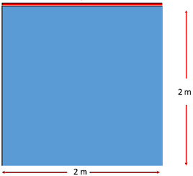
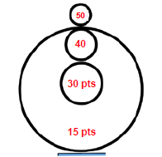
Middle School Set-Up
Launch Line
Target Area
Working Area

Slide 10
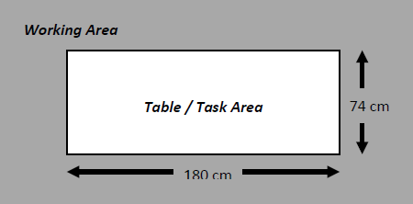
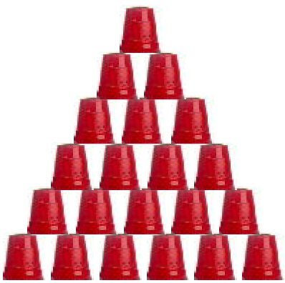
High School Set-Up

Slide 11
Scoring
Best point-to-time ratio
Middle School
Points per zone: 15/30/40/50
High School
Points per cup: 20
4 points for sketches and materials table
20% deduction for incomplete engineering notebook

