Slide 1
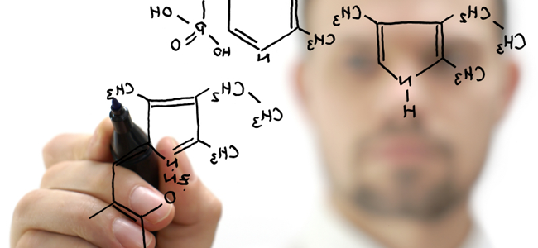
Careers In Science
Discover the Possibilities

Slide 2
A Career In The Sciences Requires:
A Good Education
High School Degree
4 Years of Lab Science
College Degree
4-5 Years to get a Bachelor’s of Science or Bachelor’s of Arts depending on the program
Advanced Degrees
Required by many professions
Additional 2-6 Years
Extra Curricular & Volunteer Work
Job Shadowing
Student Organizations and Associations
Leadership Experience

Slide 3
Medical Doctor
Undergraduate Majors:
Any major but must take a set of Core Science Classes (i.e. Biology, Chemistry, Physics)
A person licensed to practice medicine as a physician, surgeon, dentist, or veterinarian.
Further Requirements:
Medical School
Competitive application process
Need a high GPA
Letters of recommendation
High MCAT scores
Undergraduate research
Relevant experience
Save Lives

Slide 4
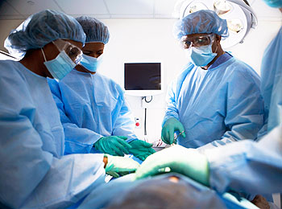
Medical Field
Physician
Studies, diagnoses, and treats diseases, and other physical or mental problems.
Prescribe Medication
Repair Bodies
Surgeon
Practices Surgery: a medical treatment that involves cutting the body.

Slide 5
Medical Field
Veterinarian: Animal Doctor
Requires the Veterinary College Admission Test (VCAT)
Care for Animals
Dentist
Dentistry: the science of preventing, diagnosing and treating diseases and injuries of the mouth
Protect Teeth

Slide 6
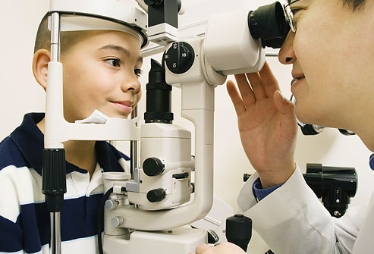
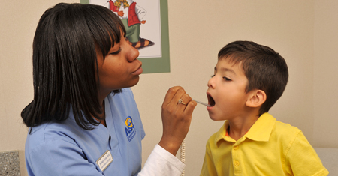
Health Care
Optometrist
Optometry: a health care profession concerned with the eyes
Protect Eyesight
Registered Nurse (RN)
Complete 4 year degree with a major in Nursing
Care for Others

Slide 7
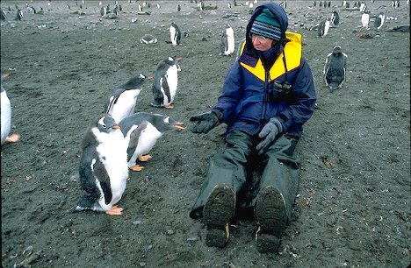
Biologist
Undergraduate Major:
Biology (General)
Biology is the study of living things (humans, plants, animals, environment)
Recommendations:
Typically need a Ph.D. to be considered a professional in the field
Ph.D. takes about 5 to 6 years to complete and the Graduate Record Exam (GRE) is required to apply
Inform the public on species

Slide 8
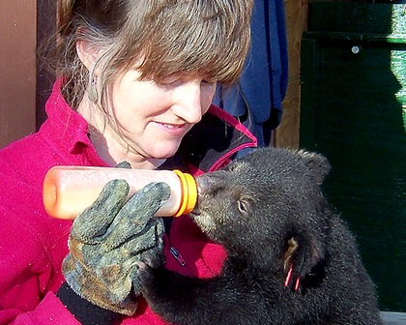
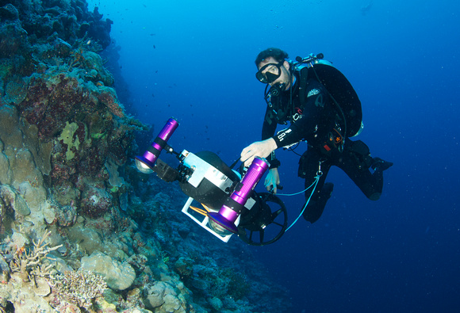
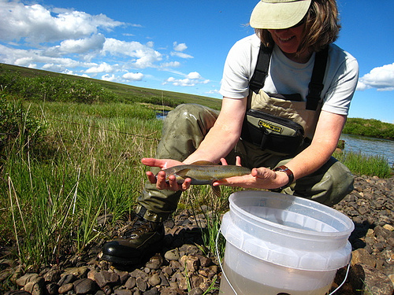
Biological Sciences
Zoologist
Major in Zoology: the study of animals
Marine Biologist
Major in Marine Biology: the study of salt water organisms
Protect
Nature
Ecologist
Major in Ecology: the study of systems of living organisms and their environment

Slide 9
Chemist & Biochemist
Chemistry is the science concerned with the composition, structure, and properties of matter
Biochemistry is the study of chemical processes in living organisms
Undergraduate Majors:
Chemistry
Biochemistry
Recommendations:
Graduate school and/or Ph.D. for those who excel in their undergraduate majors
Prepare Chemical Solutions

Slide 10
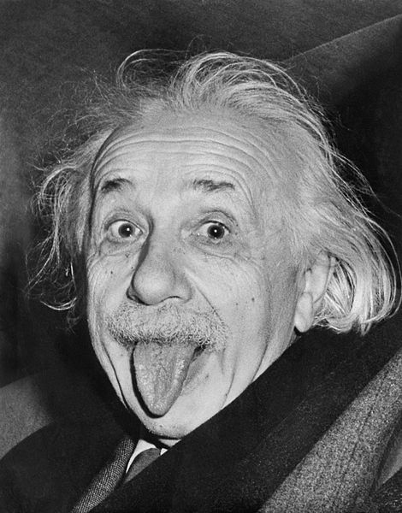
Physicist
Undergraduate Major:
Physics
Physics is the science of matter and its motion, as well as space and time (force, energy, mass, charge)
Some Careers within Physics:
Astronomy
Computer Science
Physics Education
Nuclear Physics
Design & Test
Experiments

Slide 11
Science & Engineering
Design
Prosthetics
Biomedical Engineer
Develops devices and procedures to solve medical and health related problems
Major: Biomedical Engineering
Chemical Engineer
Solve problems involving the production or use of chemicals, fuel, drugs, and food.
Major: Chemical Engineering
Monitor Nuclear Plants

Slide 12
Median Salaries per Career

