Slide 1
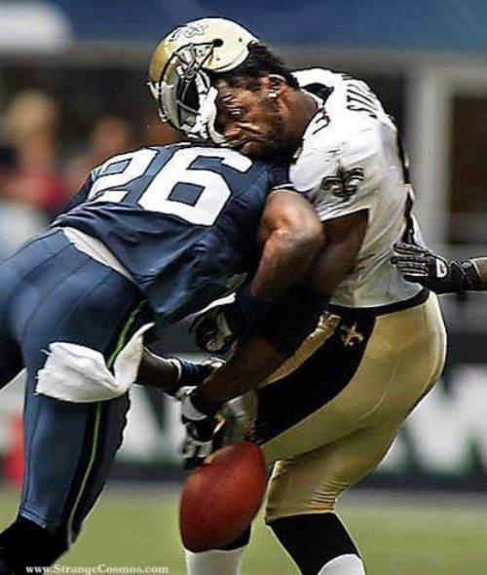
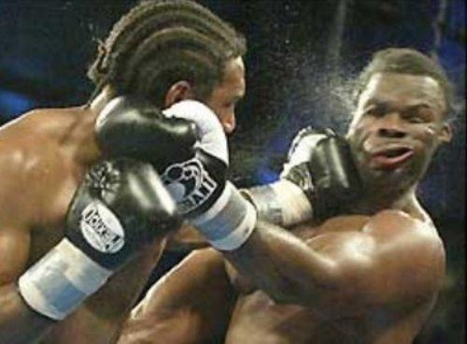
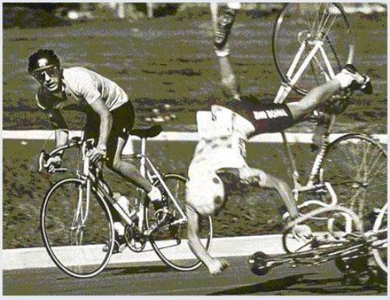
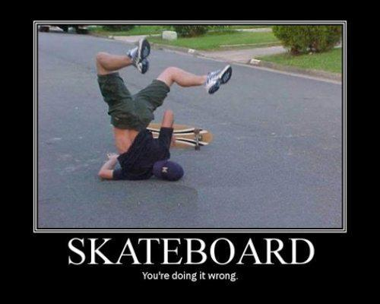
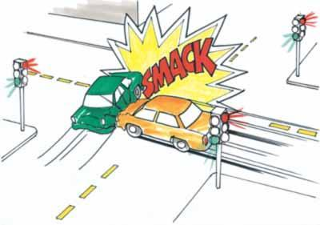
Conservation of Momentum and collisions

Slide 2
Law of Conservation of Momentum
With no external force, momentum doesn’t change
It’s the opposite of the impulse momentum relationship!
Ft = Δmv

Slide 3
Example
Consider a gun being fired.
A gun recoils when it is fired.
The recoil is the result of action-reaction force pairs.
Newton’s 3rd Law
As the gases from the gunpowder explosion expand, the gun pushes the bullet forwards and the bullet pushes the gun backwards.
What is the recoil momentum of the gun?
The same as the momentum of the gases and bullet it fires!

Slide 4
Why?
The momentum gained by the bullet is equal and opposite to the momentum gained by the recoiling gun.
They cancel each other out
No momentum is gained, and no momentum is lost.
They are within the same SYSTEM

Slide 5
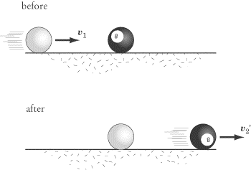
COLLISIONS
In any collision, we can say that
Net momentum before collision=net momentum after collision

Slide 6
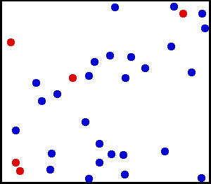
Elastic Collisions!
Elastic collision
Momentum is transferred from one object to another

Slide 7
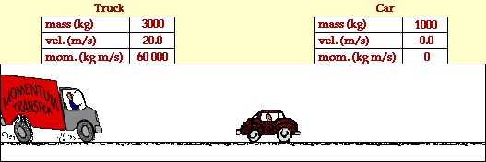
Example

Slide 8
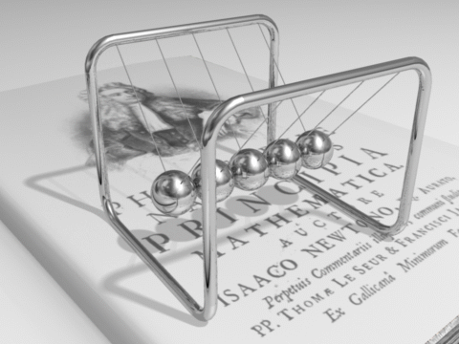
Go big or go home!

Slide 9
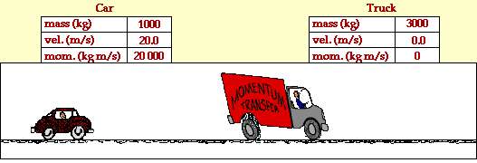
Example 2

Slide 10
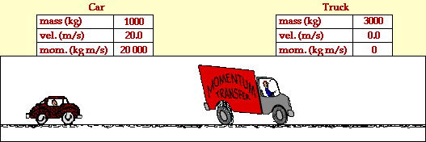
Inelastic collisions!
Inelastic
Occurs when momentum is conserved but energy is not.
Example: When objects stick together on impact

Slide 11
Example:
A freight car is moving down a track when it collides with another parked freight car. They do not stick together so the second car gets bumped down the track. What is the final velocity of the second car?

Slide 12
General formula for elastic collisions:
total p_{before} = total p_{after}
m₁v₁ + m₂v₂ = m₁v₁ + m₂v₂

Slide 13
Adrean is loving this!!
V=10
V=0
5 kg
5 kg
V=??
V =0
5 kg
5 kg

Slide 14
Example
A freight car moving along a track collides with another freight car at rest. If the freight cars are of equal mass (5 kg) and stick together by the collision, what is the velocity of the coupled cars after the impact?

Slide 15
General formula for inelastic collisions:
total p_{before} = total p_{after}
m₁v₁ + m₂v₂ = (m₁ + m₂)v₂

Slide 16
Adrean is still loving it!! Woot –woot!!
V=10
V=0
5 kg
5 kg
V=??

