Slide 1
STEM that cares: MESA, the NEDC
and Human Centered Design
Notes:
1

Slide 2
STEM that cares: MESA, the NEDC
and Human Centered Design
Carlos Gonzalez
Curriculum Specialist, MESA CA Statewide Office
Director, UCR MESA Programs
Carlos.Gonzalez@ucop.edu
951.827.2746
Notes:
2

Slide 3
Today we hope to cover:
-A glimpse into last year’s NEDC
-Key Changes this year
-Points of emphasis
-Human Centered Design and the NEDC
-HCD Exercise
-Questions? Comments?
Specific Arduino use and function will not be covered in this particular presentation…
Notes:
3

Slide 4
MESA NEDC SUMMARY
-The NEDC requires using the Arduino platform in an open-ended way to solve a real, human problem…
-The focus is on Human Centered Design and its approach to creating client focused solutions…
-The competition guidelines are meant to show how projects will be evaluated. In essence, they are not rules…
-Remains a group competition (3 – 4 students), in two divisions (middle and high school)
Notes:
4

Slide 5
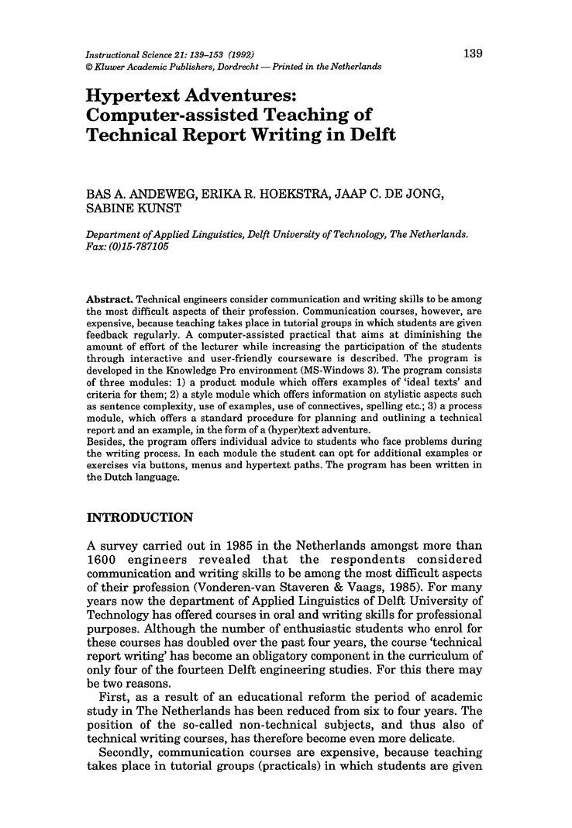
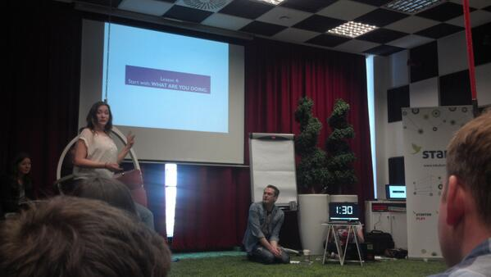
MESA NEDC COMPONENTS
Technical Interview
How the device works and why
Poster AND Symposium
A succinct summary of the project
Paper
Development of device, i.e. engineering
design process
Prototype Pitch
Selling and marketing the idea/product

Slide 6
The NEDC in 2018-19
https://youtu.be/5CRWHV5aDzE
Great projects, creativity and out of the box thinking!
Notes:
6

Slide 7
KEY CHANGES THIS YEAR
-Continuation form included in the rules…
-For TECH INTERVIEW: More points for the use of the Arduino….
-For POSTER: Took engineering design process requirement off, added points for client emphasis...
-For PAPER: Emphasizes the engineering design process more directly...
-For PITCH: More emphasis on the Business Value of device and the Client…
-Other cosmetic changes...
Notes:
7

Slide 8
Points of Emphasis…
-The Arduino needs to be at the center of the project. It should not be an ancillary piece, but an indispensable part of the project
-This is HUMAN centered design. The client matters!
-(Students) Don’t be afraid to market your product well. (i.e. don’t be too technical during the pitch)
-Read the rules and requirements. Be aware of how you’re (students) are going to be scored.
Notes:
8

Slide 9
Points of Emphasis…
-Data, data, data. Teams should have data to substantiate the effectiveness of their device.
(in addition to data that substantiates product/device need like statistics and such…)
-Finish enough. Bring projects you can demonstrate to competition…
Why are they doing this? Successful student teams are
invested in their projects with purpose...
Notes:
9

Slide 10
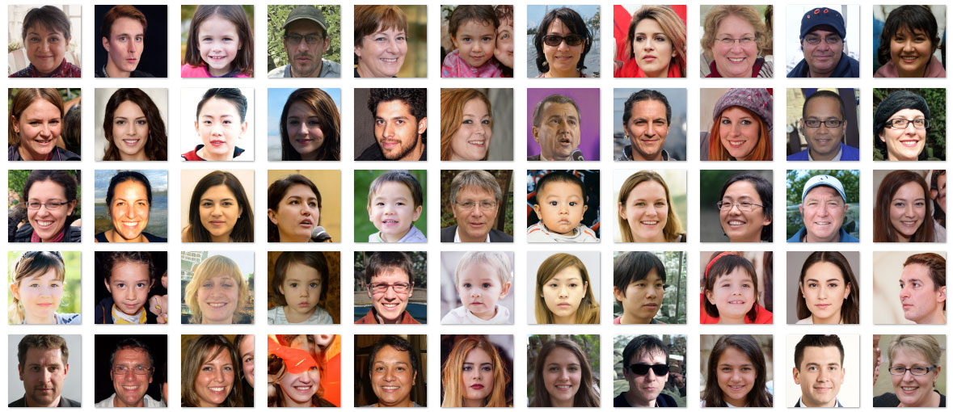
These projects have a purpose, they have “faces” if you will…
An actual human solution should be at the center of these projects!
Notes:
10

Slide 11
What is HCD?
https://youtu.be/musmgKEPY2o
Notes:
11

Slide 12
What is MESA/NEDC HCD?
Using the Engineering Design Process to arrive at Human Centered Solutions
Notes:
12

Slide 13
The key to HCD
-Creating a client centered/focused solution is the key to Human Centered Design…
-This very deliberate focus is gives a more powerful and focused direction to engineering…
-You cant help a client without first figuring out how to best help them...
-The entire process begins in determining “what to do?” or your problem to solve
How do you get started?
Notes:
13

Slide 14
MESA HCD Exercise: Problems
In a group, write down as many problems as you can think of that need to be solved...
This should all be done in the context of STEM!!!
Notes:
14

Slide 15
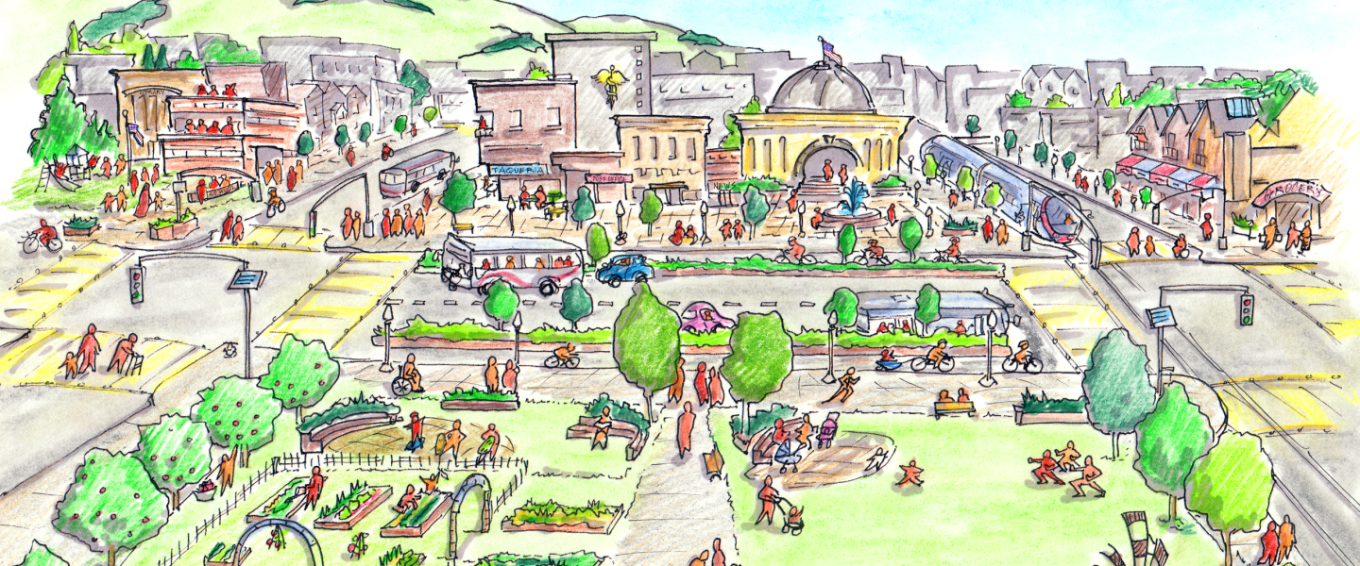
Determining a Joint Purpose...
Home Community World
Problems should be grouped in the following areas...
Notes:
15
HOME: Issues/problems that affect me in a personal way (Im directly impacted) COMMUNITY: Issues that affect people I know or may come in contact with me in my Neighborhood. I may or may not be personally affected WORLD: Issues that affect strangers and large numbers of people, but may not directly impact me in a personal way

Slide 16
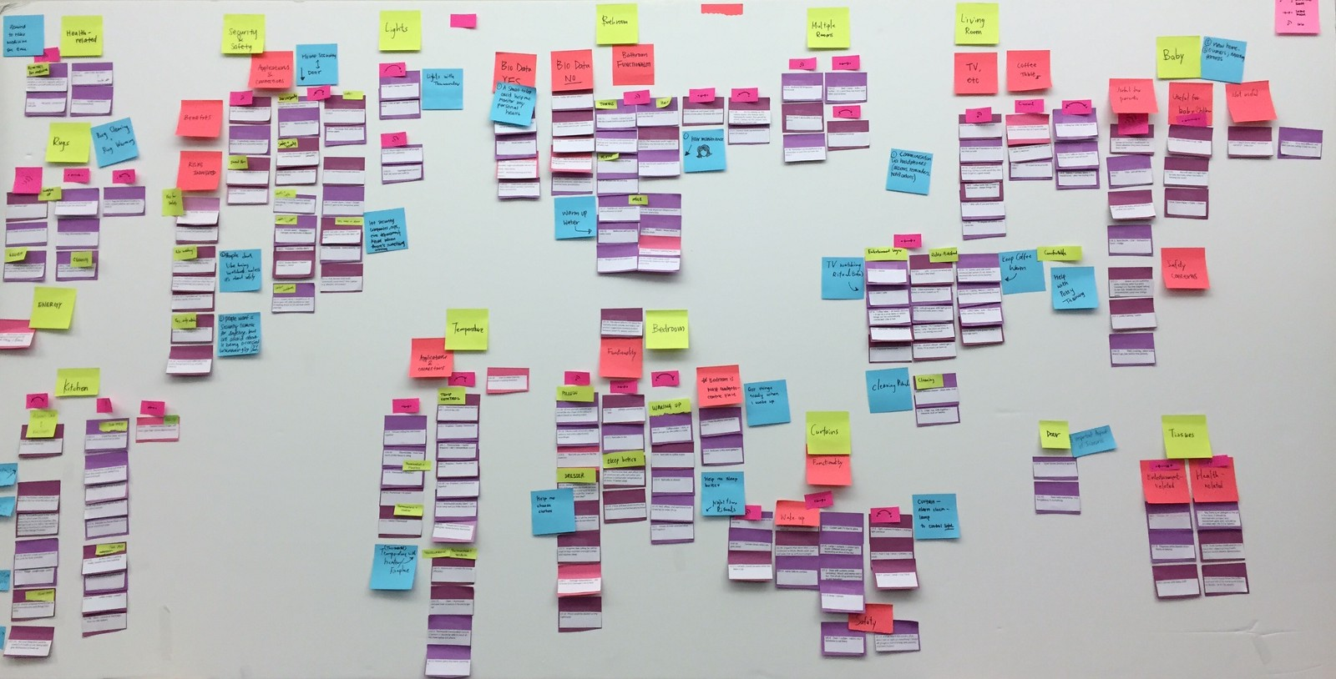
Determining a Joint Purpose...
-For the problems you come up with, unpack them if necessary
-Move the problems as needed…
-The goal is to group problems in the HOME and COMMUNITY columns…
-That is, to have a problem that can be directly engaged...
Unpacking Problems
There is too much disease in this world
West Nile Virus is spreading in our region more every year
Mosquitos are a problem in my community,,, can we prevent them?
At this point, a joint problem would need to be chosen…
and then refined further...
Notes:
16

Slide 17
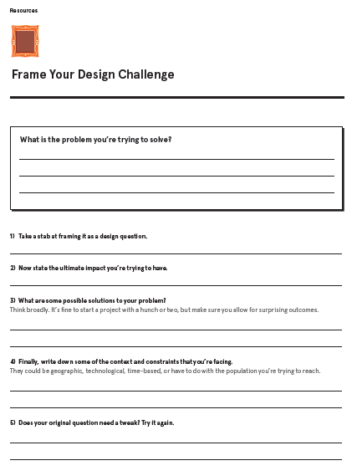
HCD FIELD GUIDE RESOURCE
Answering the questions on this sheet can help refine the problem into a more specific “design question…”
Notes:
17

Slide 18
HCD DISCUSSION: Bringing it home
-The past exercise can help your students get started with HCD.
-HCD can be an arduous process, that if done well, yields amazing results...
-Some questions to ask:
What challenges do you foresee with this type of collaboration?
How can you contextualize HCD for your audience (age group, grade, etc.)?
Would your students need more guidance than what was provided?
Are there any constraints in your space for completely open-ended projects like this?
Notes:
18

Slide 19
QUESTIONS? COMMENTS?
Carlos Gonzalez
Curriculum Specialist, MESA CA Statewide Office
Director, UCR MESA Programs
Carlos.Gonzalez@ucop.edu
951.827.2746
Notes:
19

