Slide 1
Wright Stuff Glider (MS) and Wright Turn Glider (HS)
Presenter: Ana Rodarte Sponsor: UC Santa Cruz

Slide 2
Contest Objective
Wright Stuff Glider (MS)
Students will design and construct a glider that, when launched flies through the air and lands on a target located 12.2 meters (40 feet) away from the launch area.
Wright Turn Glider (HS)
Students will design and construct a glider that, when launched flies through the air, makes a right turn, and lands on a target located 12.2 meters (40 feet) away and to the right from the launch area.

Slide 3
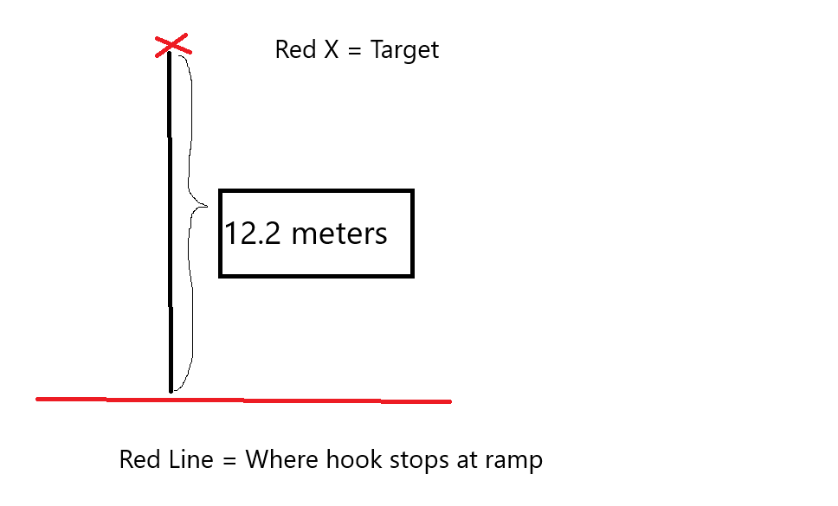
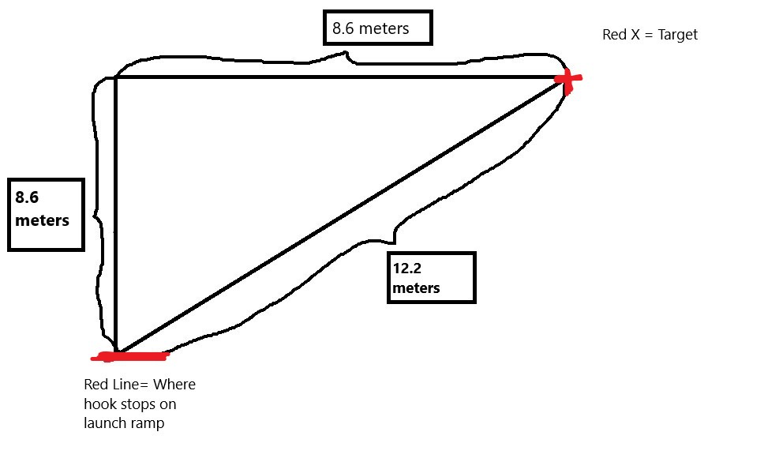
Glider Differences
Wright Turn Glider (HS)
8.6meters (28.2ft) directly in front of where the hook stops on the ramp
8.6meters (28.2ft) directly to the right
This forms a right triangle with the hypotenuse being 12.2meters (40ft)
Wright Stuff Glider (MS)
12.2meters (40ft) directly in front of where the hook stops on the ramp
No Turns. Straight shot.

Slide 4
Materials
For both glider competitions, all materials are legal except for:
Power (Thrust, Lift, or Stored Energy)
Remote Controls
Prefabricated Gliders
You can use parts of a kit, but not the entire kit as provided.
Suggested Materials:
Balsa wood: Light wood that helps with flight, but is delicate to work with (breaks easily).
Modeling Clay: Some clay at the tip of the nose adds weight
Glue: Any type

Slide 5
Contest Overview
Glider MUST be properly labeled and include: the first and last name of all team members, school name, grade level, MESA Center name, and a red dot to identify the glider feature that will adapt to the laucher hook. A 10% penalty will be given to gliders that are not properly labeled.
Gliders checked in with a tie-on label will be tested with the label attached.
Teams must be ready within 30-seconds of being called by judges.
Each team will have 2 non-consecutive launches and 2 minutes to set-up for each trial. Teams will receive a 5-second count-down before the launcher’s trigger is released.
Both launches will be timed (to be used as the tie-breaker only). The glider with the longest single flight time will be declared the winner. A glider’s hang-time will be recorded, at a minimum, to the nearest hundredth of a second.
Gliders MUST remain in the impound when not being repaired or launched.
Ideally, the glider competition should be held indoors, but it depends on the spaces available.

Slide 6
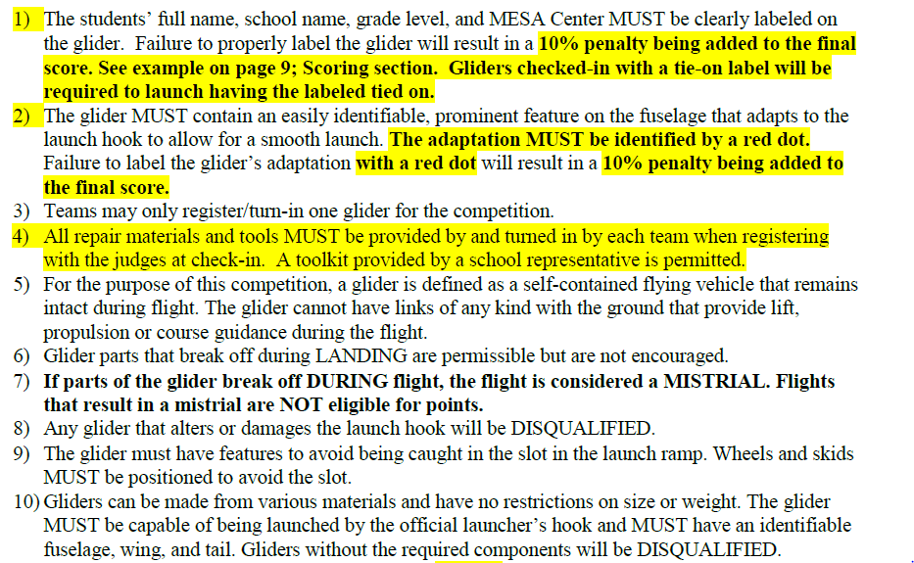
Middle School & High School: General Rules

Slide 7
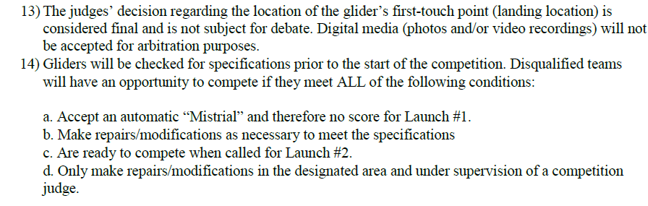
Middle School & High School: General Rules (cont.)

Slide 8
Middle School & High School: General Rules (cont.)

Slide 9
Disqualifications (DQs) and Scoring
Disqualifications: The following disqualifications apply to both glider competitions:
Parts breaking off during flight or takeoff
Altering/Damaging the launch hook
Not having the following identifiable components:
Fuselage
Wing
Tail
Scoring:
The best of the 2 non-consecutive launches make up your score (closest distance to the target)
Launch Score = distance from target NOT distance traveled
Final Score = Best single launch plus the possible
If two teams have the same final score, then the glider with the longest single flight time will be the winner of the tie.
Penalties (50% missing lab book, 20% incomplete lab book, and/or 10% improper labeling)

Slide 10
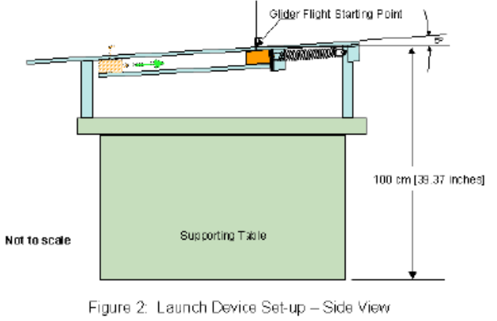
Event Management: Official Glider Launcher
Components:
Tension Spring (11”)
McMaster-Carr (Part Number: 9640K243)
$5.59 (before tax)
Launch Platform
Surface Size (length): 178cm (58 inches)
Surface Size (width): 30.5cm (12 inches)
Made from ¼” thick composite board or comparable material
Launch Hook: 0.160” diameter
McMaster-Carr (Part Number: 9594T13)
$8.25 (before tax)

Slide 11
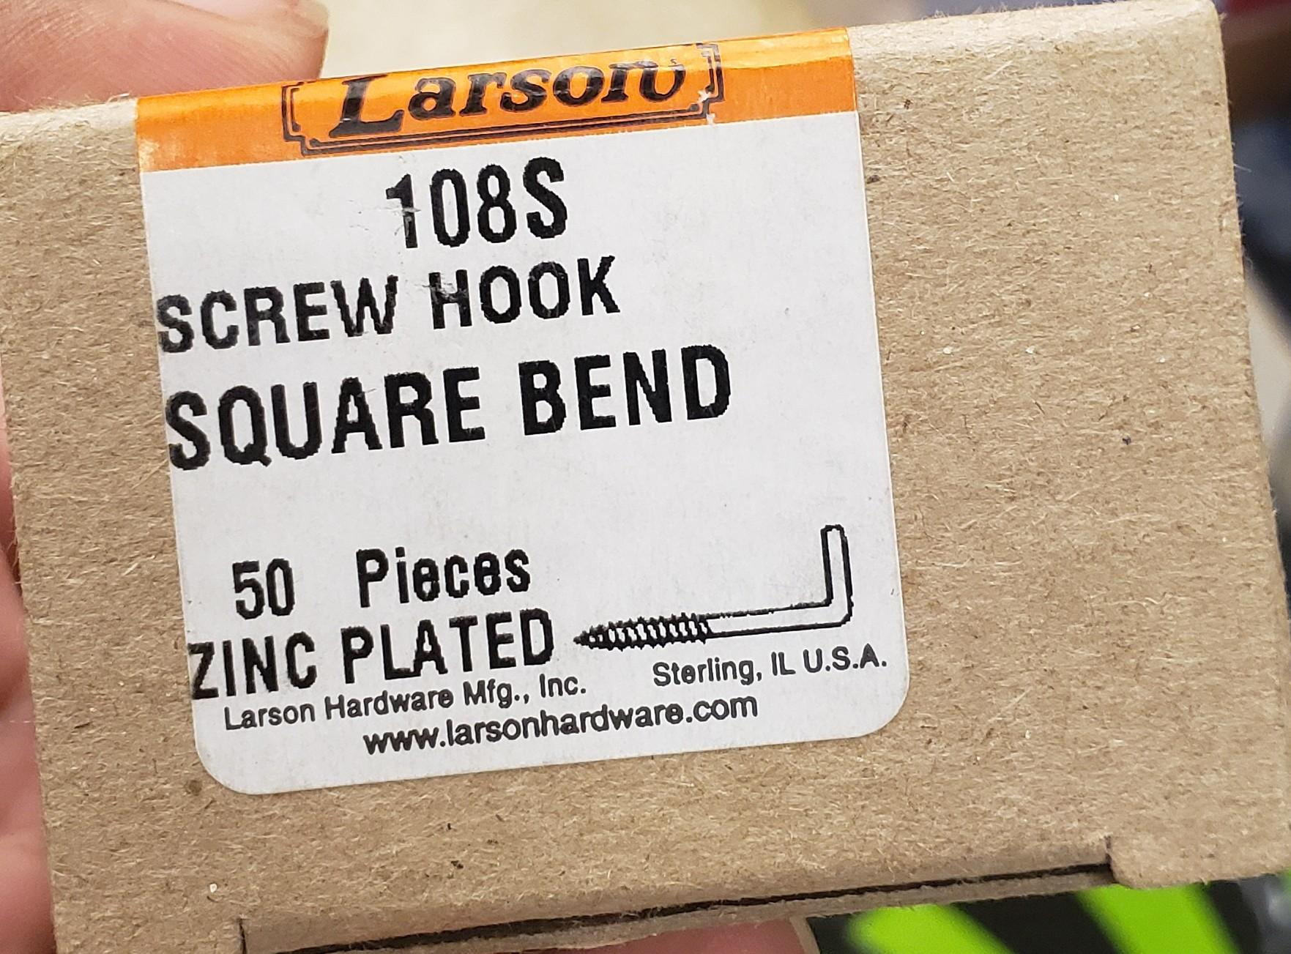
Correct Type of Hook
Wrong Type of Hook

Slide 12
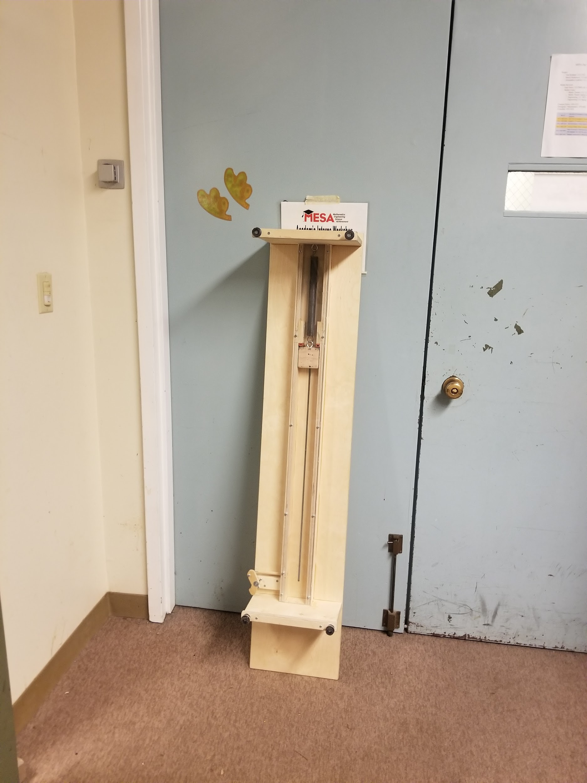
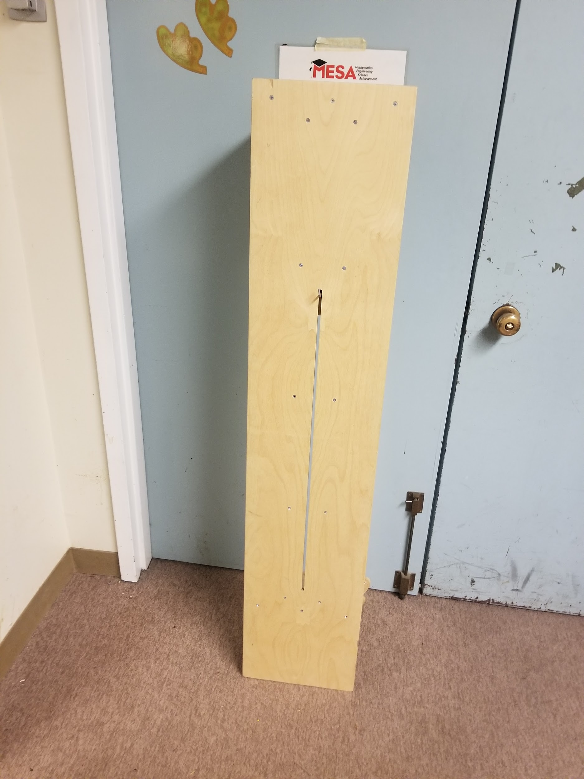
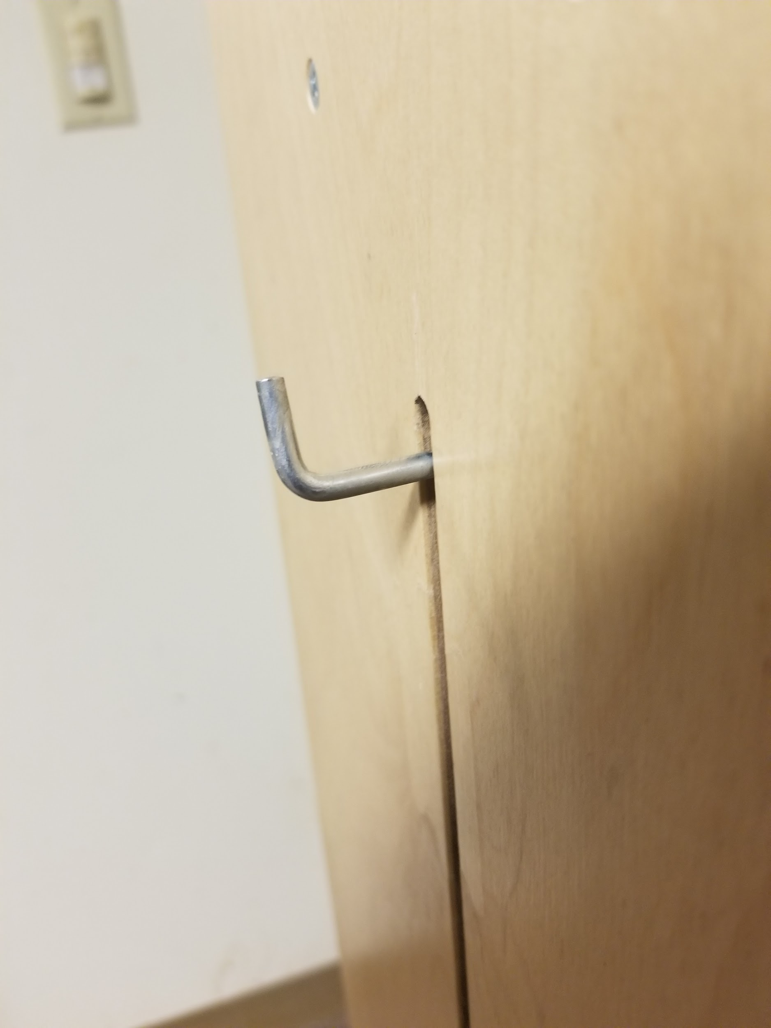
Glider Launcher Overview
Rear View
Front View
View of Hook

Slide 13
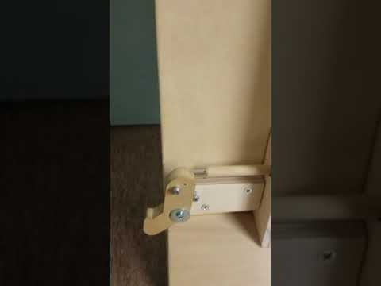
How the Launcher Works

Slide 14
Event Management
The following materials are needed to run the competition:
Tables (6):
1 six foot table for the Launcher
1 six foot table for the Repair Station
2 six foot tables for Impound for middle school
2 six foot tables for Impound for high school
Room for competition (recommended): Indoors (based on availability of facilities)

Slide 15
Event Management
Recommendations in order to run the event the same way at all MESA Days.
Do’s
Number the teams and post-its before first launch
Judges
1 at impound station
1 at repair station
3 Time Keepers
30-second competition ready confirmation by team
2-minute set up with launcher
Hang time for each trial
2 First-touch point spotters
1 with launcher & gives 5-second count-down
Each contest has its own launcher; MS/HS are separate
Have one launcher as back up.
Post-Its from Office Depot to mark the first touch point of the glider.
Dont’s
Use a launcher without replacing the spring and hook.
Try to run MS and HS competitions at the same time.

Slide 16
Middle School Gliders: Target

Slide 17
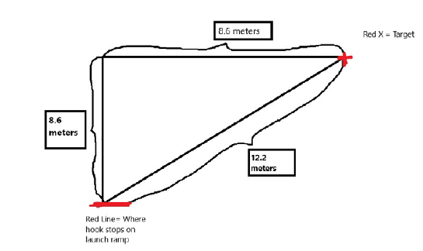
High School Gliders: Target

Slide 19
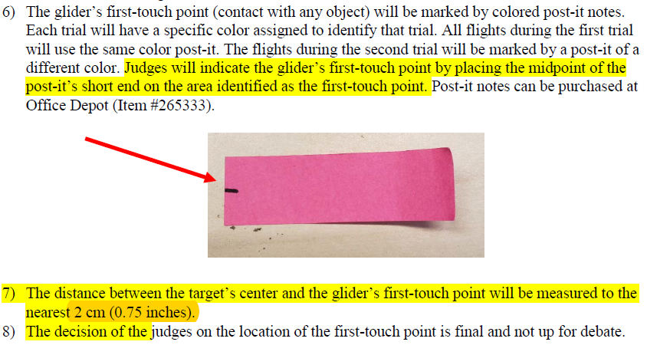

Slide 20
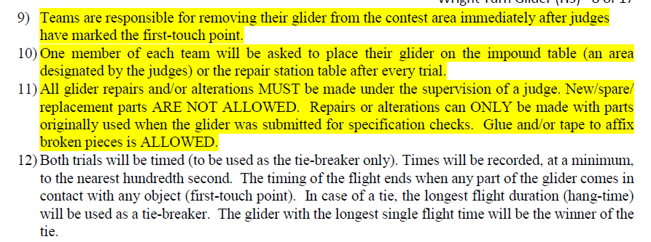

Slide 21
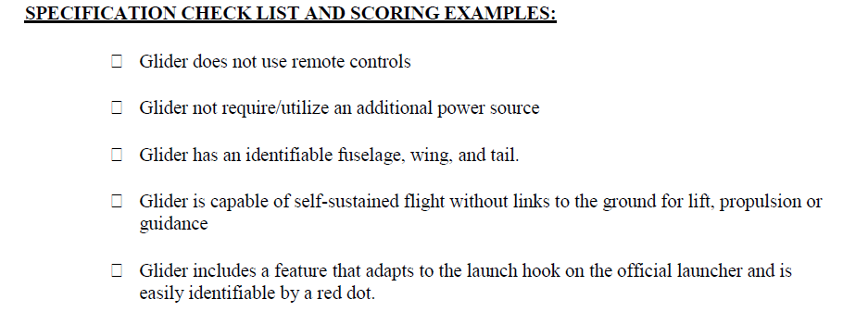
ANY QUESTIONS?

Slide 23
ANY QUESTIONS?

Slide 25
ANY QUESTIONS?

Slide 26
Aspect Ratio and Ideas for Student Activities

Slide 27
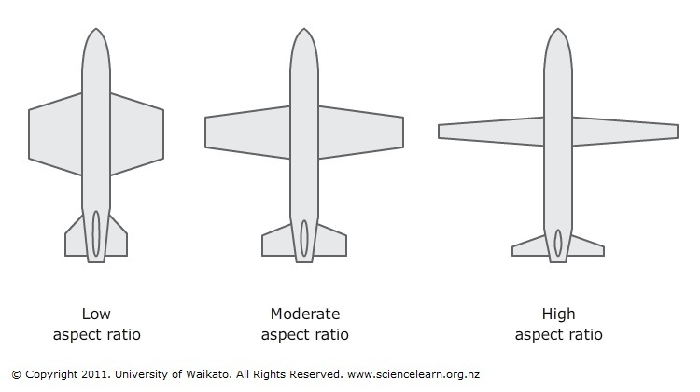
Aspect Ratio
What is Aspect Ratio (AR)? AR is the ratio of the length of wings to their width
Low Aspect Ratio
Go slower unless they have power to combat drag.
More manoeuvrable
More drag (opposition of aircraft motion through the air)
High Aspect Ratio
Long Narrow wings give the plane more stability
Not very manoeuvrable
Less drag

Slide 28
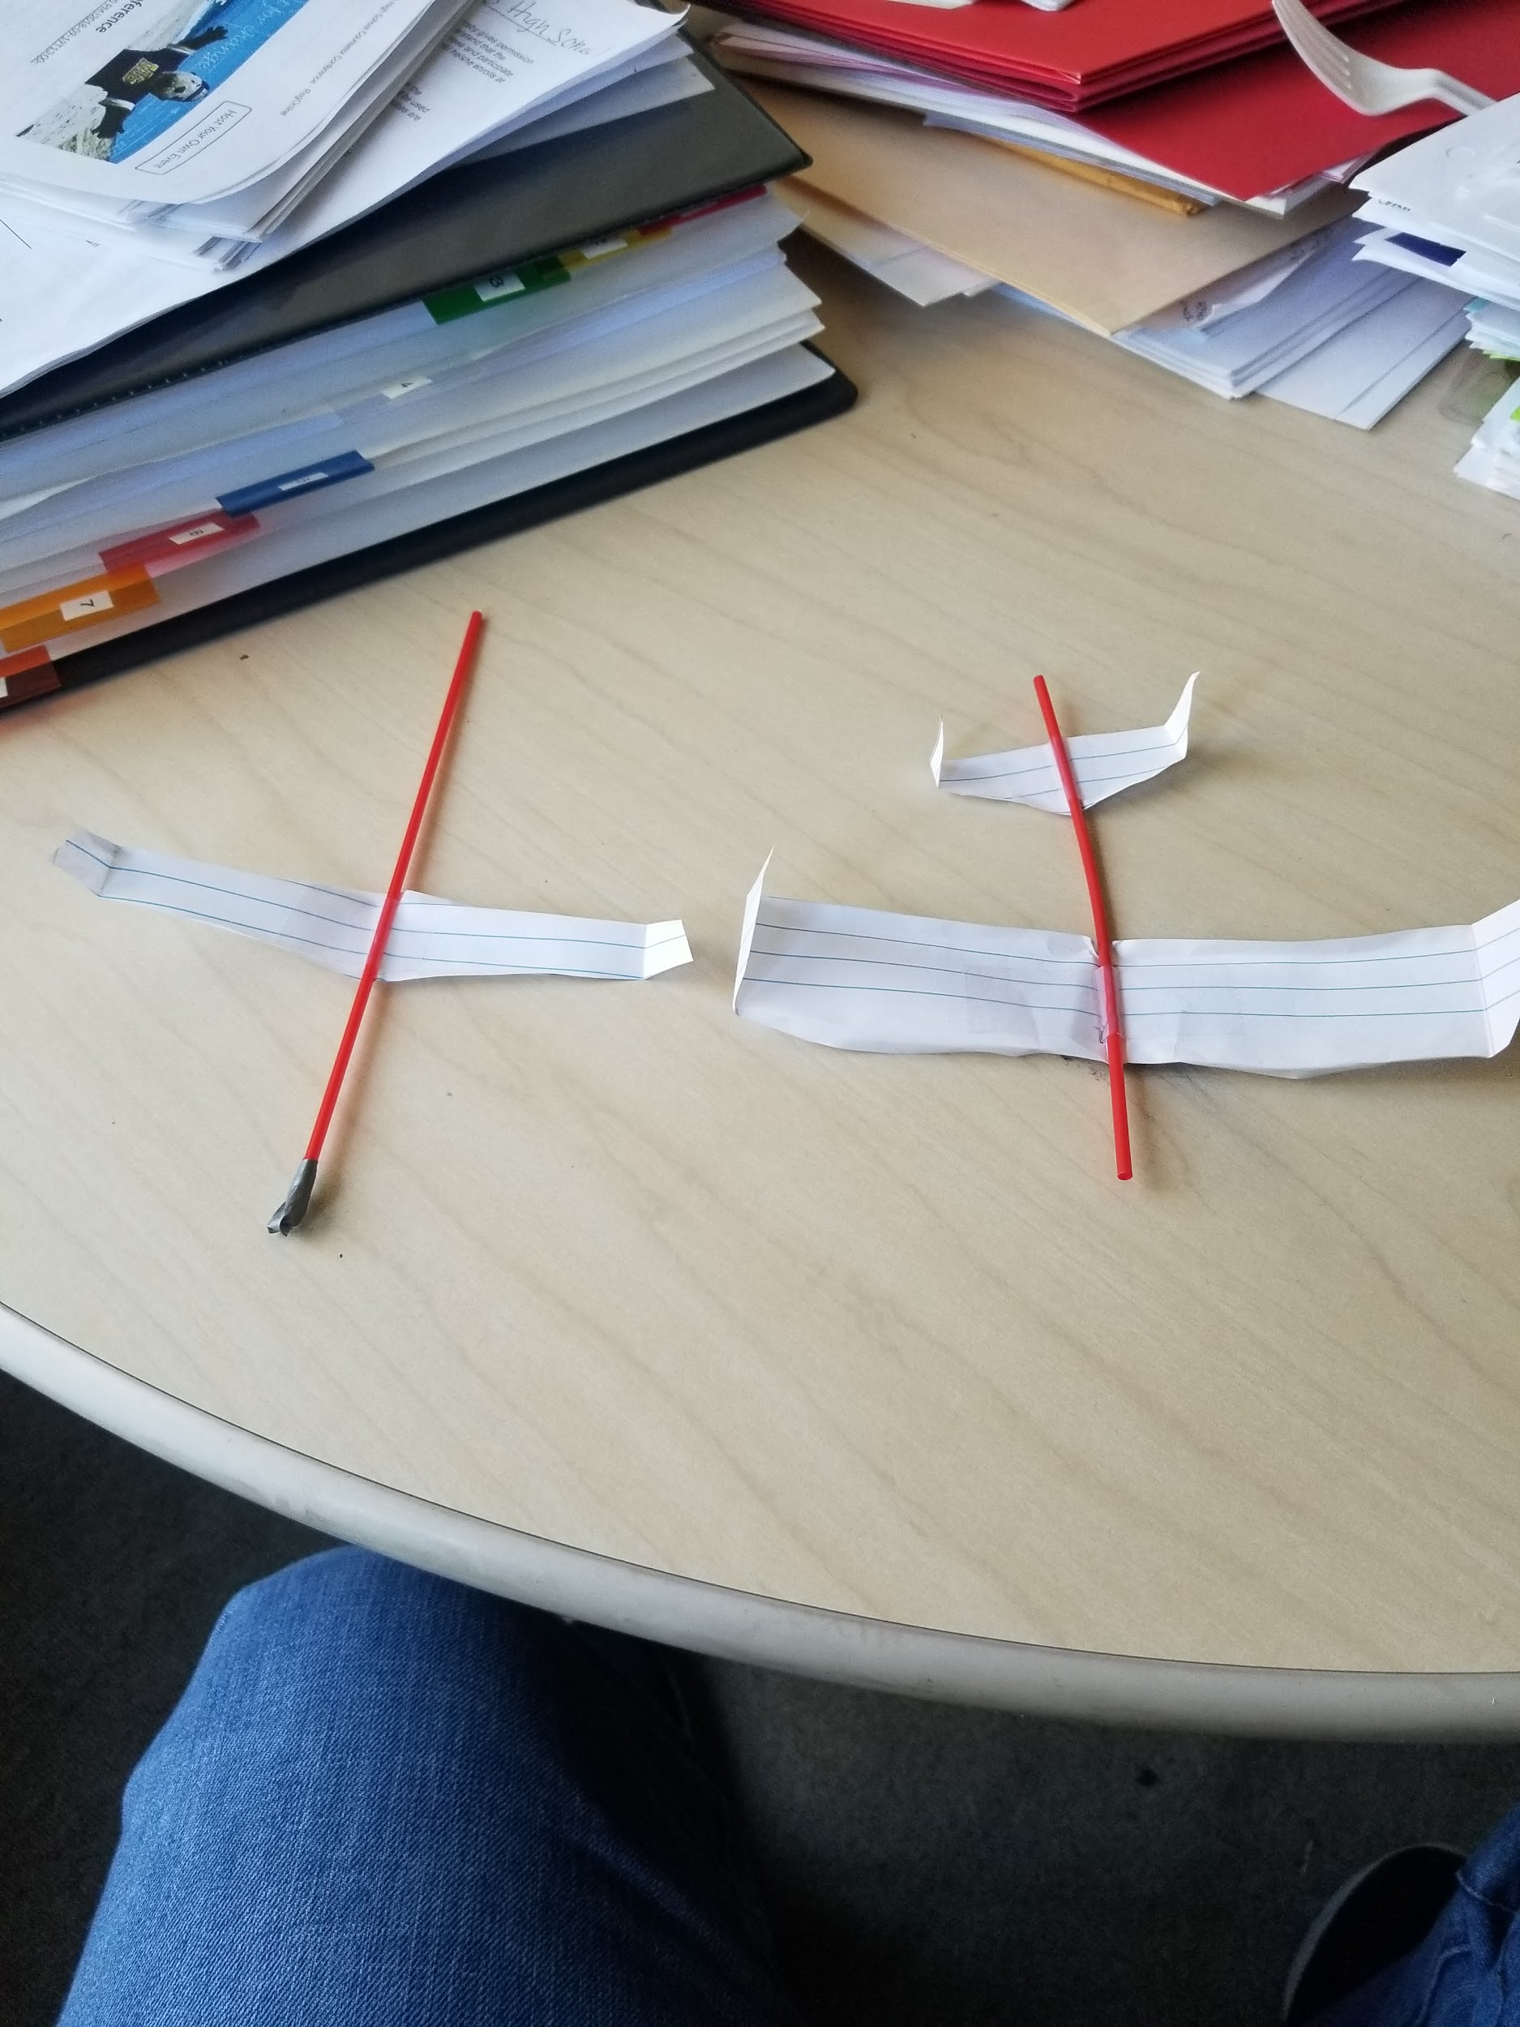
Example Activity
Coffee Stick Glider
Overview: To familiarize students with the Aspect Ratio. Students will construct a makeshift glider using the following materials:
Regular (Lined or Blank) Paper
Coffee Stirring Straw or toothpick
Tape or glue
Scissors
Have students design different shapes of wings and tails to see what the best design would be to a). Launch the farthest distance and b). Have the greatest hang time.
Suggestions:
When making the wings, keep in mind the aspect ratio. The Aspect Ratio of a wing is calculated by dividing the wing length by the wing width.
Wing Length
Wing Width

Slide 29
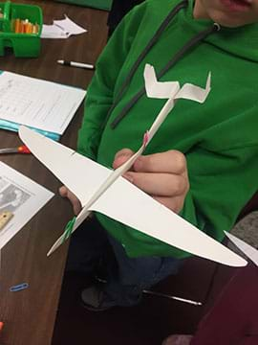
Hands-on Activity: Better by Design
Each team will construct a glider and have four trials to record the distance traveled. After all four trials have been recorded, students will need to calculate the average distance traveled. The first trial is to get a base of characteristics for the glider (distance, measurements, etc...). After each trial, students will be asked to change one controlled surface, but all else has to remain the same from the original design. For example, if you change the wing span in trial# 1, you must change it back to the original design in trial # 2.
Materials: The following materials will be used for this activity:
1 sheet of 8.5 x 11 cardstock paper
Scissors
3 Large Paper Clips
1 Pencil
1 Ruler
Optional: 1 calculator
Activity Link

Slide 30
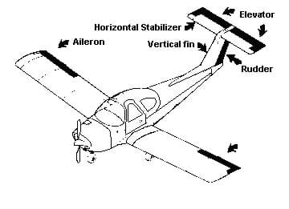
Labeled Glider Parts

Slide 31
More Resources
More Resources:
NASA’s Wright Index
NASA’s Aerodynamic Index
How Shape Affects Lift
Inclination Effects on Lift
Aerodynamic Forces
Factors that Affect Lift
Glide Angle
UCSC Glider Demonstration
Making Your Glider Turn

