Slide 1
Implementation Webinar
Jan 22, 2015

Slide 2
PAC 2.0
Changes to PAC Competition for the 2015-16 academic year.
Cost of device cannot exceed $80.00
Arduino must be used to open and close device fingers
Can have on finger stationary and one which moves
Cannot use wrist of fingers to control device in any way
Unencumbered hand can be used to activate device.
Can use other body parts to activate i.e. foot, sound, breath
Different team member must perform each trail
Poster must include block diagram of Arduino Programming
Pseudo code must be included in appendix
Discussion must detail integration of electronic into device
Batter powered
Can use DC power supply
Canuse potentiometer to adjust voltage

Slide 3
PAC 2.0
Provide judges with copy PAC Competition Rules, and Event Management Docs
Judges must review and be familiar with sections they are judging
Lead Judge should be familiar with all rules
Different judges for HS and MS competitions*
Suggestion:
For both prelims and regionals host a webinar or in-person meeting to meet with judges to review judging of competition and answer questions.

Slide 4
Competition Day
Before beginning the competition
Gather all competitors and review the rules and explain the competition process
i.e. location of rooms, order of device performance
Have teams choose order in which they will compete for the Device Performance
Regional: Based on the order chosen, have student participate in the Academic Poster Presentation in the opposite order
Each site should have a representative participating in judging of each component of competition at regional level

Slide 5
Use of Microcontroller
Student can use devices other than the SparkFun Redboard microcontroller.
The board used must be Arduino compatible
Possible brands include
Arduino Uno
Sparkfun Redboard
16Hertz Uno R3
Have to have documentation that it is Arduino compatible and have a picture of the device

Slide 6
Use of Microcontroller
At the State & National Level, students will be asked to bring laptop the spec check and show judges the programming
Judges need to look for the following statements in the programming to verify Arduino Programming
Void Set Up
Void Loop\
Teams must comment sections in their program to indicate what is being done in sections
Site have the option of verifying programming in the same manner of choosing at the lower levels
Can have students send program via email day before
Print out a copy to submit during check-in

Slide 7
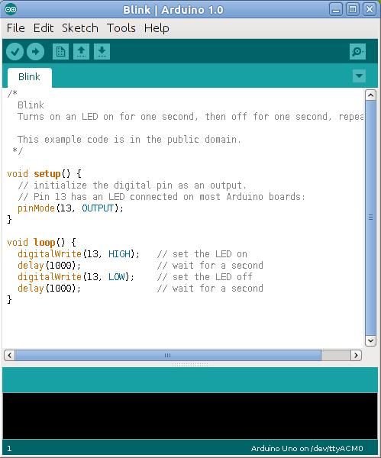
Use of Microcontroller
Comments

Slide 8
Judging
Number of Judges
PAC Component | Middle & High School (# judges)
Technical Paper | 3
Academic Poster Presentation | 6 at regional level
Device Performance | 7 - 8

Slide 9
Judging – Technical Paper
Equipment Needed
Competition Rules
Score Sheets
Pens
Preliminary –
judges receive technical papers at least a week before competition
Depends on number of papers being submitted
Can implement deduction for late papers up to a certain date
Documents must be submitted as .pdf format
2 – 3 judges; each judges should read all papers

Slide 10
Judging – Technical Paper
2 – 3 judges; each judges should read all papers
Have judges read and score papers independently
Papers should be read a scored before competition.
Provide scores to lead judge before competition
Regionals/State
Same as preliminary competition except
judges receive technical papers 2 weeks before competition
3 judges; each judge should read all papers

Slide 11
Judging – Academic Poster Display
Preliminary
Option to have students submit poster during prelims but not present
Suggestion: Have teams submit posters electronically with technical paper to check for required components

Slide 12
Judging – Academic Poster Display
Equipment needed
Easels
Poster Boards to mount posters
Score Sheets
1 open room
Judges = 3
Regional/State
Impound posters at same time as device.
Have judges start scoring posters while students are in math competition
Judging should be completed before presentation

Slide 13
Judging – Academic Poster Display
Suggestion: Score posters in opposite order of team order in device performance.
Suggestion: After judging of a poster is completed move posters close to door so students can have access to poster for presentation
When scoring is competed submit scoring sheets to Lead Judge

Slide 14
Judging – Academic Poster Presentation
Equipment needed
Easels
Poster Boards to mount posters
Score Sheets
1 classroom
Judges = 3
Preliminary/Regional
Presentation: 3 minutes followed by 1 minute of Q &A
Signal when team has 1 min and 30 sec remaining for presentation
Complete score sheet after each presentation
Note: The above time can be increased up to 10 minutes depending on the number of teams competing

Slide 15
Judging – Academic Poster Presentation
State/National
Presentation: 10 minutes followed by 5 minute of Q &A
Signal when team has 3 min, 1 min and 30 secs, 10 secs remaining for presentation
Submit score sheets to Lead Judge after all presentations are completed

Slide 16
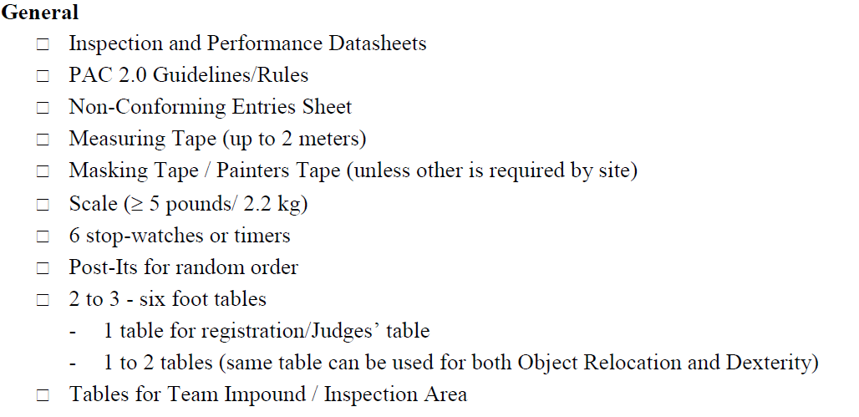
Judging – Device Performance
Equipment Needed:

Slide 17
Judging – Device Performance
Equipment Needed:

Slide 18
Judging – Device Performance
Equipment Needed:

Slide 19
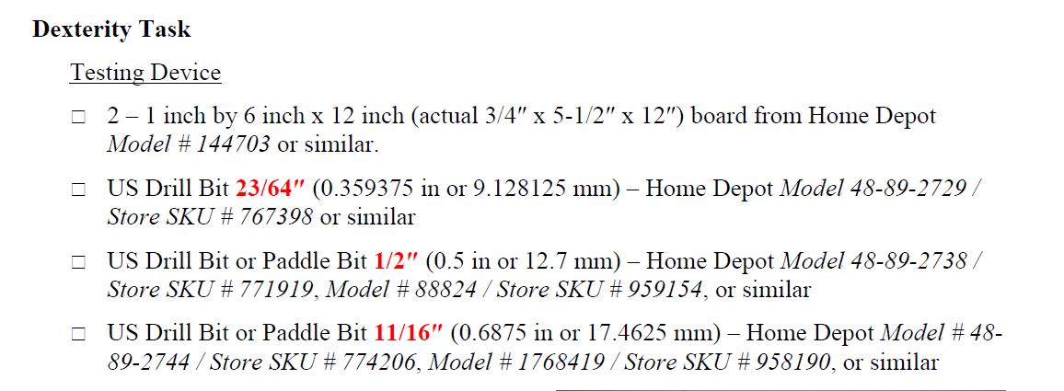
Judging – Device Performance
Equipment Needed:

Slide 20
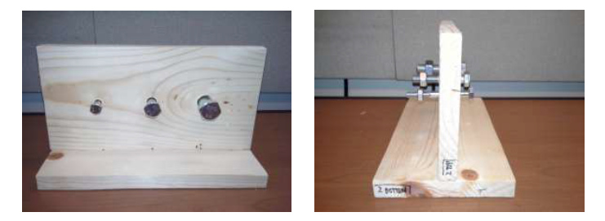
Device Performance
Dexterity Task

Slide 21
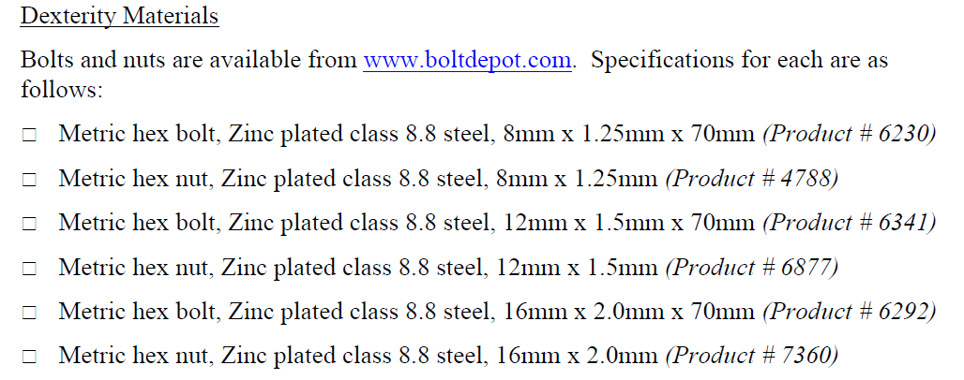
Judging – Device Performance
Equipment Needed:

Slide 22
Judging – Device Performance
Equipment Needed
1 large room need to accommodate the following
Laptop
Calipers (2)
Competition area consisting of
MS: 2 tables for device performance; 6 tables for impound area; 2 table device check-in/scoring
HS: 3 tables for device performance; 6 table for impound area; 2 table device check-in/scoring

Slide 23
Judging – Device Performance
Set-Up
If possible lead judge, judges and staff should set-up room the night before the competition.
Competition area is the same set up as previous years
Make sure to test nuts and bolts for dexterity task to make sure they move smoothly

Slide 24
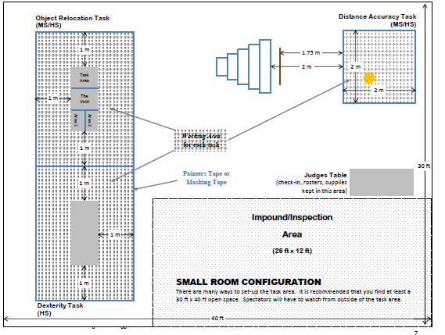
Judging – Device Performance
Small Room Set-Up

Slide 25
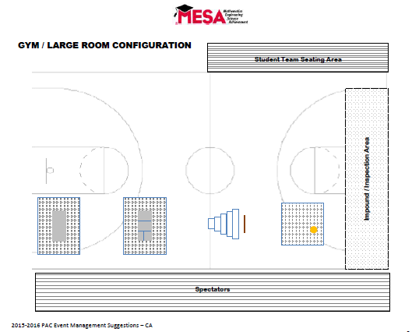
Judging – Device Performance
Large Room Set-Up

Slide 26
Judging – Device Performance
Device Check-In
Set up two tables for
Device Check-In
Check for students name, school and MESA Center on device.
Team member complete Inspection and Performance Datasheet
Take photo of team with device and sign with school name*
* Center can make signs a head of time and use sign to denote the teams impound area

Slide 27
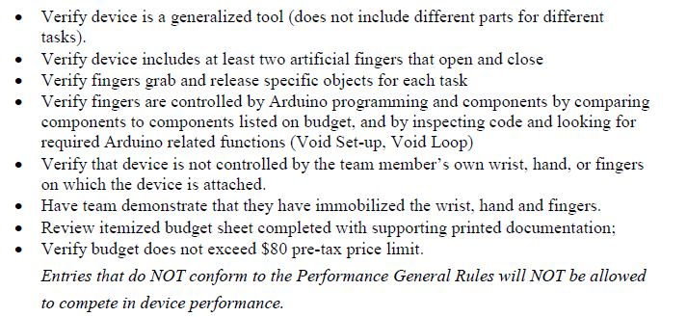
Judging – Device Performance
Device Check-In (cont.)
2. Device Weigh-In
Weigh device and record weight on Inspection and Performance Datasheet
Check for following

Slide 28
Judging – Device Performance
Device Check-In (cont.)
2. Impound Area
Assign each team to a impound area
Once the device is in the impound area teams are not allowed to touch device until it is time to perform task
Direct teams to sitting area to wait for competition

Slide 29
Judging – Device Performance
Competition
Before beginning the competition, inform all observers of the rules set up for observing
Not contact with team device
No speak to judges
No assistance in repairing, adjusting, to teams

Slide 30
Judging – Device Performance
Competition
Each team will have two trails
Trails can be consecutive or non consecutive
Trails at different tasks can run simultaneously
Call teams in order to compete in the device performance
Teams will proceed in following order
In-Hole – team in impound area preparing device
On-Deck – team preparing for next task

Slide 31
Judging – Device Performance
Team–Up – team prepare to perform task (1 minute)
Team has 1 minutes to prepare for task
Team indicates ready to operate status
Time Takers and Recorders ready for team performance
Start Task performance

Slide 32
Judging – Device Performance
Dexterity (2 minute)
Record time
Use calipers to score bolt
Object Relocation Task (1 minute)
Record time
Score the items in the finishing area
Distance Accuracy (1 minutes)
Record time
Score bean bags
Overlaps between two zones receives lesser score
Partial outside of boundary no score

Slide 33
Judging – Scoring Tools
All score sheets should be submitted to Lead Judge at end of competition for scoring
New scoring tools have been created
HS Scoring Tool
MS Scoring Tool
Also have created a Budget Sheet
Budget Sheet
Information about specifics of competition rules provided in the PAC Overview Presentation which is on the MESA Curriculum Website

Slide 34
FAQ
Question: Can they use two red boards on one arm ?
Answer: I don't see anything in the rules that prevent you for using 2 Arduino boards
Question: Can they use a UNO (blue board) instead of the Sparkfun red board?
Answer: Yes you can use the Arduino UNO instead of the Redboard.
Question: Are we allowed to buy an "already manufactured" robotic hand? Or do we have to make it?
Answer: No students are not allowed to by a robotic arm they must build it and program it using the Arduino. As state on page 2 of the rules it states " Teams will research, design, build, test and compete using a prosthesis designed to complete the following tasks ...“

Slide 35
FAQ
Question: Can we use our forearm to turn the prosthetic hand in a circular motion? We know we can't use any part of our arm to open and close the device but we want to know if we can move our arm in a circular motion to utilize the prosthesis to turn things. We ask this because the "nut and bolt" section would require one to screw something in via circular motion which would require the usage of our forearm and even our wrist.
Answer: You can use the forearm to turn the prosthetic arm as that would be a normal movement for someone using a trans-radial prosthetic. However, you may not use your wrist because it should be immobilized.

Slide 36
FAQ
Question: Are immobilization devices weighed as part of the device? Please also define what it means to be a means of "immobilization."
Answer:. Immobilization objects that are separate from the device itself are not considered part of the device and will not be weighed. The purpose of the immobilization is to restrict the movement of the wrist and fingers to prevent them from contributing to the function of the device.
Question: In general rule 7 it states that the unencumbered hand may be used to activate Arduino components. Can you define what activate means ?
Answer: In this case activation means either providing power to the system (i.e. turning a switch to on) or initiating the programming at the beginning of the task trial. Once the trial begins the unencumbered hand can no longer interact with the device and/or the Arduino components.

Slide 37
2016 PAC 2.0 Competition Dates
CA Local Competition: Check with local MESA Center for competition dates
Regional Competition:
North: April 30, 2016 @ UC Davis
Central: April 9, 2016 @ CSU Fresno
LA Metro: April 9, 2016 (HS) @ CSULB; April 23, 2016 (MS) @ UCLA
South: April 9, 2016 (MS) @ UCR; April 16, 2016 (HS) @ Imperial Valley
Check with host center for Technical Paper due dates
CA State Competition @ UC Irvine: May 14, 2016
Technical Papers due: May 7, 2016
National Competition in Utah: June 21 – 25, 2016
Technical Paper due: June 3, 2016
Email to mailto:nationalcompetition@mesausa.org
Late papers accepted up to June 5, 2016 with 10 point deduction

